Slide 1
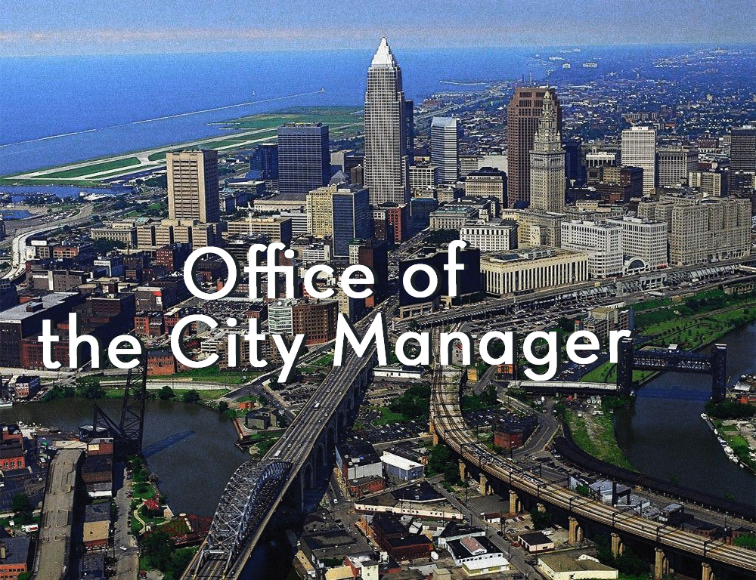
“So You Want to be a City Manager?”
Forum 2018
Moderator- Terrence W. James
April 20, 2018
Track 1 (1.3)
Notes:
Delete the logos, change image

Slide 2
Purpose: To obtain an understanding of what is takes to be a city manager
Day in the Life
Roles and Responsibilities
Problem of Practice
Current Issue
Preparation and Advice
Education and Training
Tools for Success
Daily Agenda
Helpful Habits
Work-Life Balance
Problem Identification
Processing
Solution Development
Outcome Evaluation
Experience

Slide 3
Day in the Life of a City Manager
Aretha Ferrell-Benavides
Early AM | Mid AM | Noon | Mid PM | Late PM | Other Notes
News Emails | To-do List Morning Meetings | Lunch with Agency Lead(s) Admin Work | Review of Hot Button Issues Community Meetings | Evening News Follow-up on emails | Use of a Franklin Planner Learn to Delegate
Rashad Young
Early AM | Mid AM | Noon | Mid PM | Late PM | Other
Coffee/Breakfast (Internal and External Partners/Staff) | Media/Press Management Deputy Mayor Meetings | External Meetings | Agency Director’s 1:1 Agency Visits | Community Hours Special Events | Exercise Self Reflection/Strategic Thinking

Slide 4
Day in the Life of a City Manager
Norton Bonaparte
Early AM | Mid AM | Noon | Mid PM | Late PM | Other
Work | Work | Work | Work | Work | …
Nicole Ard
Early AM | Mid AM | Noon | Mid PM | Late PM | Other
Morning Walk Review of Urgent Emails and News | Check in with Staff | Variable Activities | Lunch with Staff / Community Meetings | Council/Community Meetings Check Emails | Exercise Schedule Varies by Day Faith Ongoing Communication with Council

Slide 5
Problem of Practice: Public Safety
Problem/ Topic: Issues in Public Safety
(Sanford, FL)
Thought Process
Engagement with Police Department
Consultation with Elected Officials
Solution Development
Working Group Developed to Discuss Community and Police Challenges
Recommendations are to be Submitted
Outcome Evaluation
This is Ongoing
Community Stakeholders

Slide 6
Problem of Practice : Budget Balancing
Problem/ Topic: Budget and Finance
(Petersburg, VA)
Thought Process
Reframe the Issue
Extensive Resources and Time
Solution Development
Creative Financial Savings Options
10% Agency Budget Reduction
Outcome Evaluation
Balance Budget
Clean CAFR
Understanding the Context and History of the Problem

Slide 7
Problem of Practice : Budget Balancing
Problem/ Topic: Budget and Finance
(Washington, DC)
Thought Process
Engage Agencies and Communities on Budget Requests
Prioritize Requests
Solution Development
Compromise, Negotiate and Compromise
Match Priorities with Mayor’s Vision
Outcome Evaluation
Annual Agency Performance Plan
Clean CAFR
Understand the Needs and Requirements

Slide 8
Problem of Practice : Public Safety
Problem/ Topic: Issues in Public Safety (Sandusky, OH)
Thought Process
Communicating with Government Stakeholders (Council and Legal)
Engaging Community and Receiving Input
Solution Development
Collaborating with internal and external partners
Outcome Evaluation
Receiving Community and Staff Feedback as a tool to Evaluate Success

Slide 9
Preparation and Advice: What did it take to get to where you are now?
Education
Work Experience
Training

Slide 10
Audience Questions
Closing Remarks

Slide 11
Thank You
Aretha Ferrell-Benavides (Petersburg, VA)
Rashad Young
(Washington, DC)
Norton Bonaparte
(Sanford, FL)
Terrence W. James (Washington, DC)
Nicole Ard
(Greenbelt, MD)

