Slide 1
More Than Just The Blues
Proposal of a Mental Health Toolkit for Faith Based Organizations
Notes:
Raise your hand if you are a member of a church or faith based organization?

Slide 2
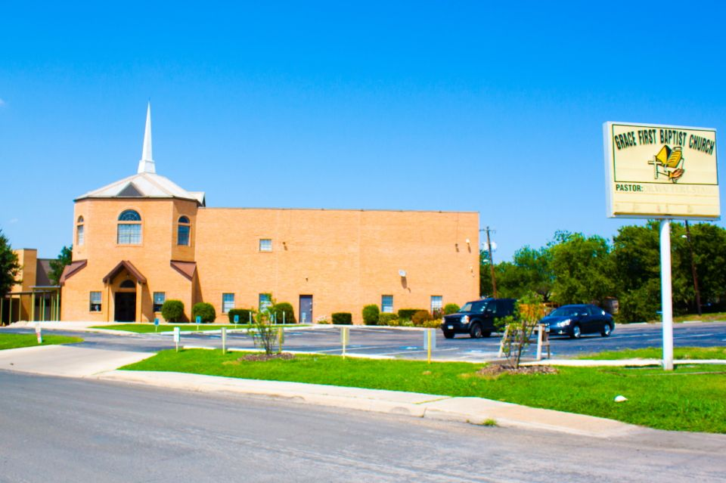
Notes:
I grew in san Antonio Texas. My dad finished off is air force career in this town and when we got there in 1997 the first thing my parents did was find a church home. It was a predominantely African American church with a pretty large military presence named Gracce Frist Baptist Church where my Pastor was Rev. Dr. Walter L Starks
The community of the black church
Graduted went to school and began to notice that there was Certain topics that just didn’t get brought up in my started to learn the role that your community plays in health outcomes became fascinated with programs that toom place in the faith based setting and in that process started to notice that there were certain topics that didn’t get discussed at church or in the black community broadly

Slide 3
If you were to tell a member of your church or FBO that you thought you were struggling with depression what response would you get?
Prayer
Encouragement
Doubt
Judgement
Notes:
Community hs the opportunity

Slide 4
Notes:
Depression is one of America’s most common mental disorders
African Americans are disproportionately affected my diagnosed depression in addition to symptoms od depression
Risk factors for mental illness like racism, discrimination, low economic status seen more in AA communities
AA that suffer from mental illness also face chronic disease and disability at higher rates
Stigma in African American community around mental illness Led to decrease treatment, lower quality of life
Attitude often not accepting of those with mental illness or depression
Topic of depression not discussed.
Stereotypes of the “strong black woman, strong black man” feed into existing issue

Slide 5
Goals
Goal #1: Increase the screening and follow up treatment for African American adults with depressive symptoms
Goal #2: Decrease the attitude and stigma around mental health in the African American community while embracing existing faith-based networks and practices
Notes:
Methodology

Slide 6
Objectives
Increase use of screening tools
2. Gain support of faith-based leaders and peers
3. Increase dialogue and availability of educational materials
4. Introduce/familiarize members with mental health professionals
5. Create sustainable efforts that keep the conversation going

Slide 7
Toolkit Components

Slide 8
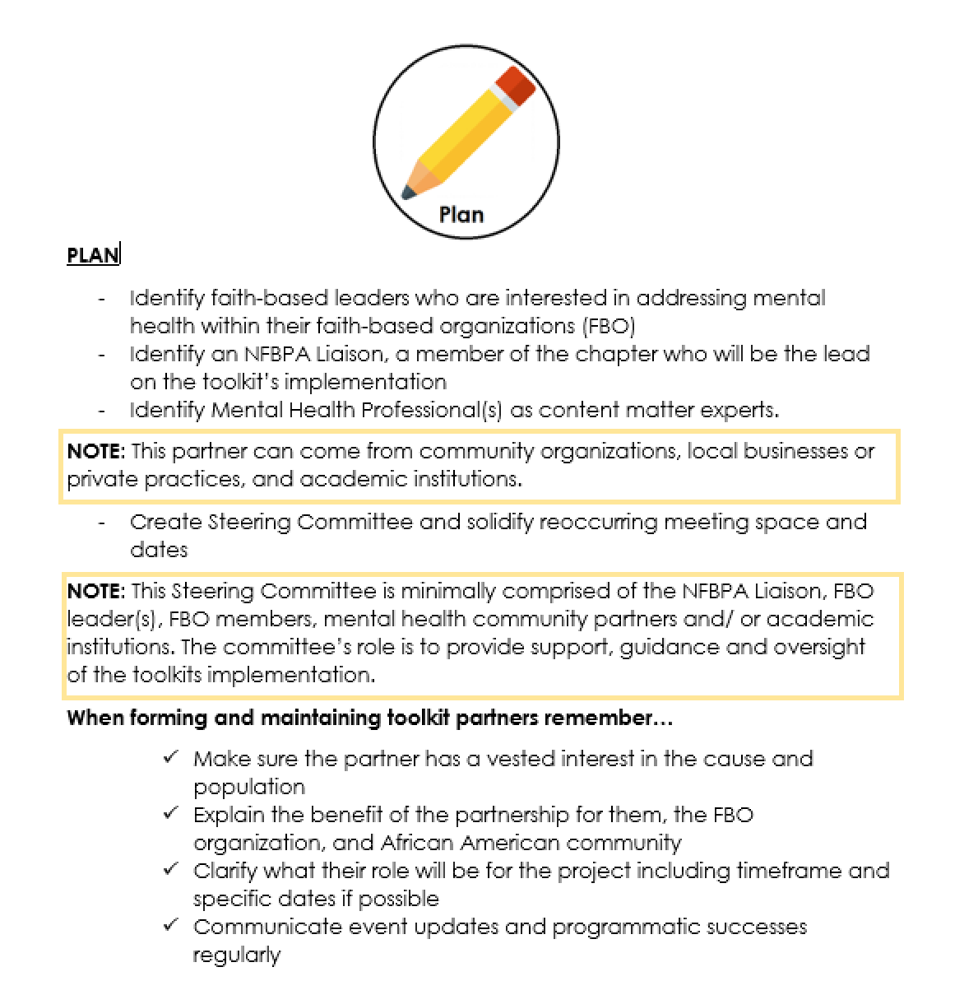
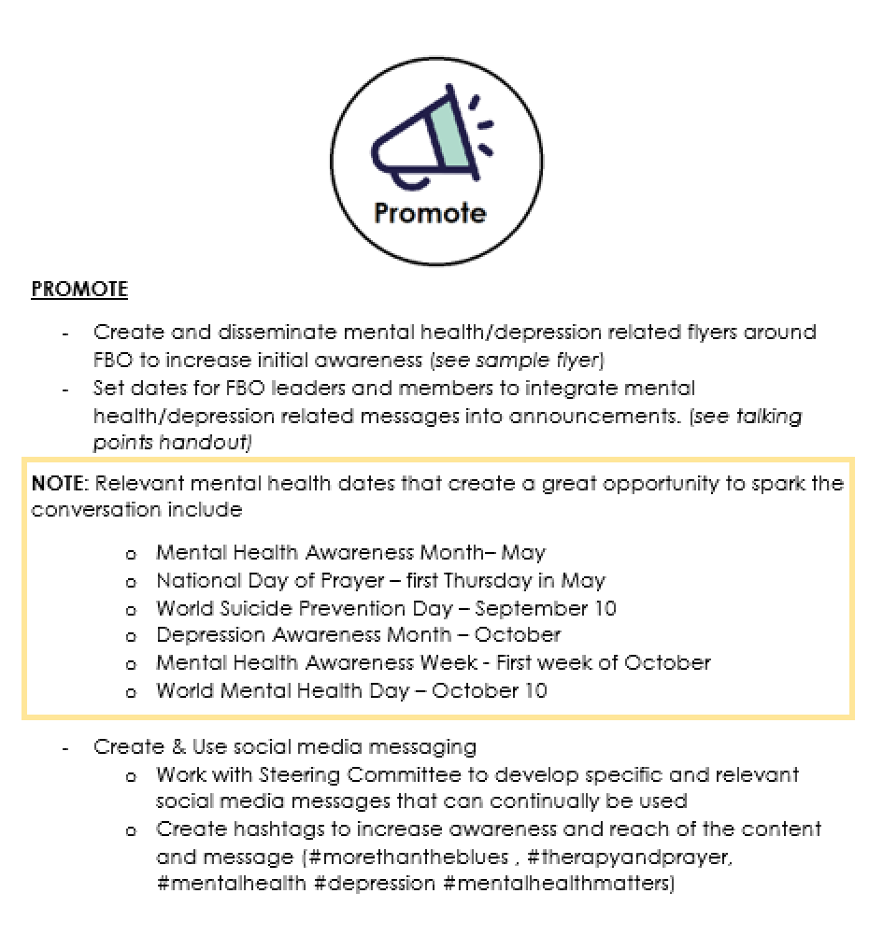
Plan

Slide 9
Meet the Mental Health Professional Events
Resource Table
Depression Checks (Patient Health Questionnaire 9 (PHQ9)
Rely on Mental Health Professional and Community Partners
Therapy Resources
Prayer Group/ Small Group
Add mental health as a focus within health ministry
Create specific mental health ministry (resource available)

Slide 10
Evaluation Method
Inputs | Activities | Measured Outputs | Short Term Goals (constructs) | Intermediate Goals (behaviors) | Long Term Goals
-Implementation Staff - Relationships with faith-based organization and health care networks - Mental health professional relationship -Paper resources | Outlined in Mental Health Toolkit | -# of faith-based organizations reached out to -# of faith-based organizations participating -# of individuals screened -# of individuals educated -# individuals diagnosed with clinical depression or depressive symptoms -# that sought follow up treatment -# of mental health events within the year | -Increase knowledge of depression symptoms, prevalence, screening & treatment - SECONDARY: Improve attitude related to stigmatization of depression/mental health diagnosis and treatment | PRIMARY: Increase screening & follow up treatment for AA adults with depression | Improve quality of life for those with Depressive symptoms

Slide 11
Notes:
Public health issue

Slide 12
HUGE Thank You
Derrick Neal
Executive Director of the Victoria County Public Health Department
Mentor & Project Sponsor
Gwen Sims
Director of Nutrition and Chronic Disease for Harris County Public Health
Dr. Sherri Onyiego
Chronic Disease Physician for Harris County Public Health

