Slide 1
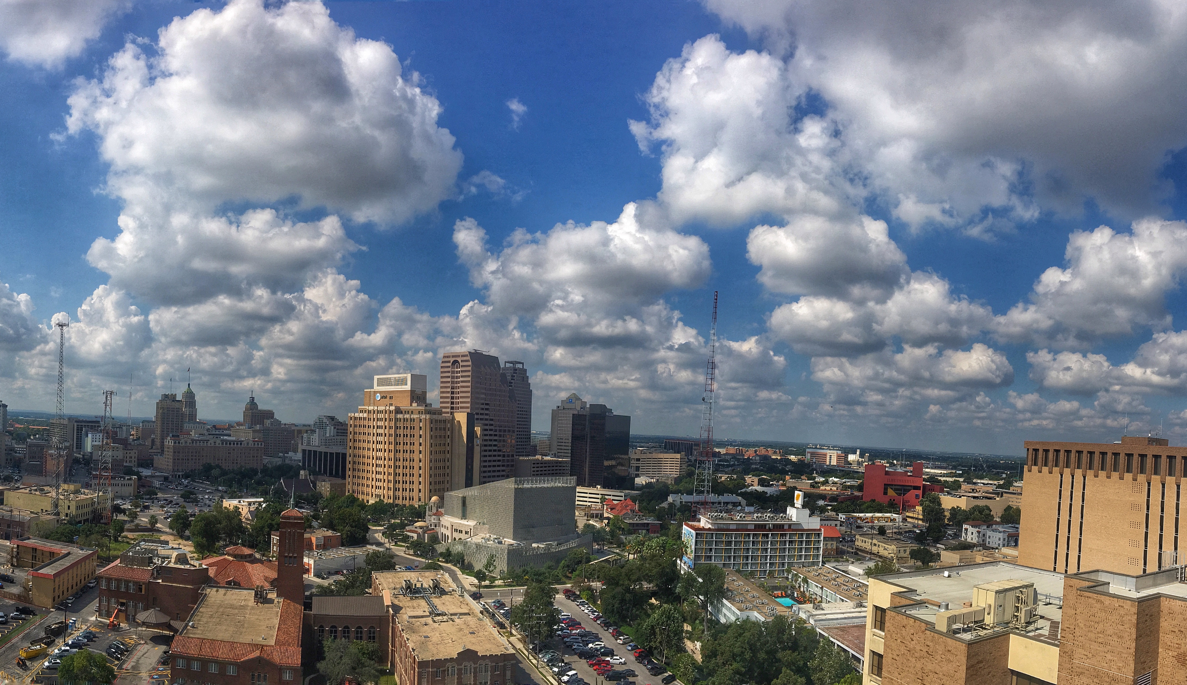
INTERAGENCY PARTNERSHIP – BRIDGING THE GAP OF THE DIGITAL DIVIDE
Demetrius Payton // Data Center Systems // CPS Energy
Notes:
We did not inherit San Antonio from our fathers. We are borrowing it from our children.
San Antonio is the seventh-largest city in the nation.
It was also one of the fastest growing large cities in the country in the past ten years.
Goal –
Objective –
Cost Implication –
Impact to the community -

Slide 2
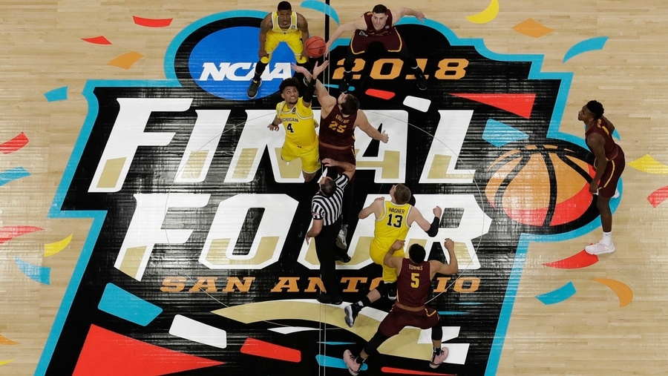
100,000 visitors during this year’s NCAA Final Four
Notes:
Introduction
Since the last Final Four in 2008, our population has swelled by almost 20 percent.
100,000 visitors came to our city during Easter weekend
Villanova may be the NCAA champion this year, but it was San Antonio that won the Final Four!

Slide 3
Notes:
Agenda
Purpose of the Study
Research Question
Digital Divide
Embracing the vision
Projects
Recommendation

Slide 4
In 2017, one in four San Antonio households lack internet.
Notes:
Purpose of the study
Quality of life
Digital literacy
Economic growth and equality
Social mobility

Slide 5
The Digital/Divide
63%
Percentage of schools lacking the bandwidth necessary to meet modern digital education needs
Percentage of households run by a college graduate with access to high speed internet
HAVE-NOTS
90%
< 30K/yr
Inner city schools
No degree
> 60K/yr
49%
Over 65 yrs old
College grads
Average percentage of US Blacks and Hispanic Households without access to high speed internet
Percentage of US Adults without home internet connection due to sell reported ”lack of skill”
7%
HAVES
Notes:
The digital divide

Slide 6
Notes:
Agenda
Purpose of the Study
Research Question
Digital Divide
Embracing the vision
Projects
Recommendation

Slide 7
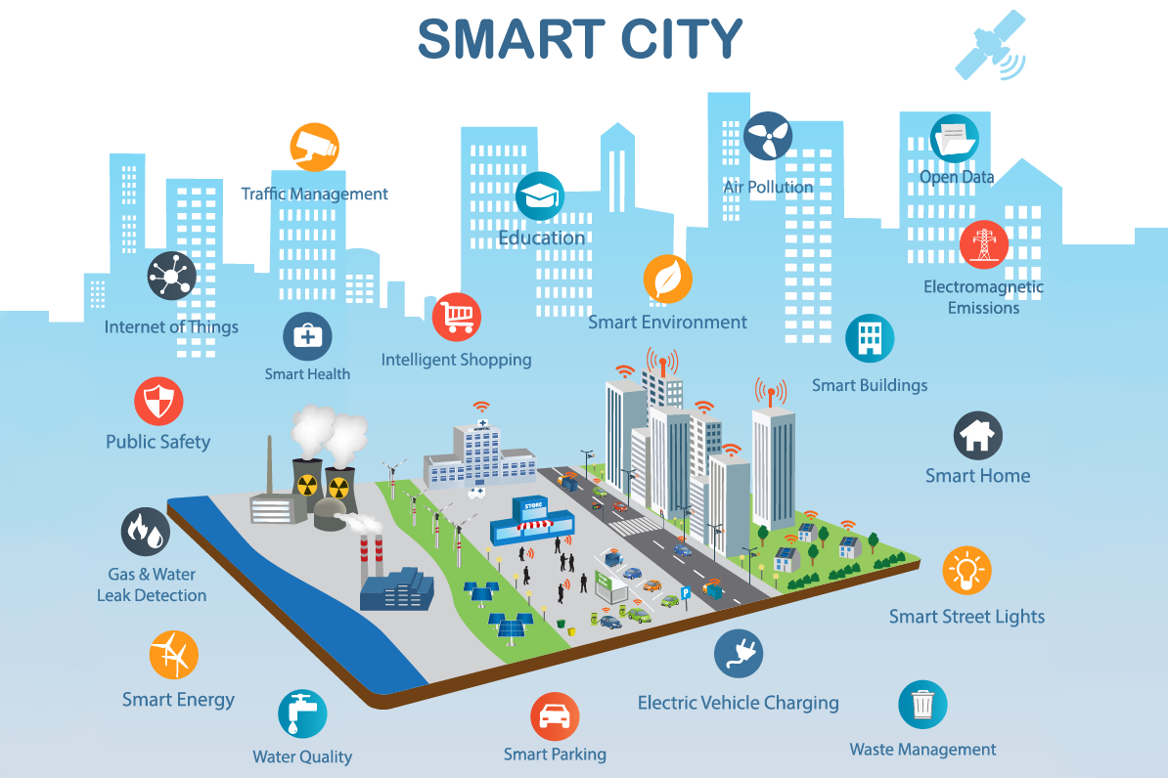
Notes:
Embracing the vision

Slide 8
CPS Energy has over 700 miles of dark fiber
Notes:
Providing interagency resources for fiber improvement, data center colocation, and network services.

Slide 9
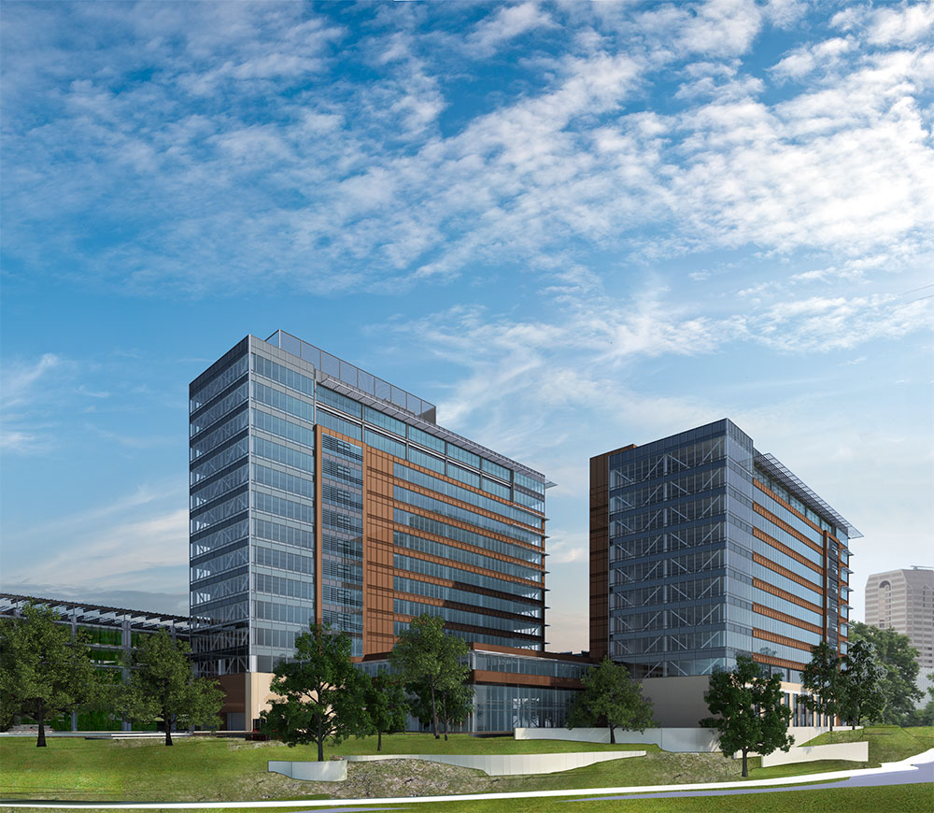
Business Case
Play a leadership role in our community that results in the efficient use of public funds.
Lower costs for governmental entities that provide public services.
Reduce waste for city and county services by not duplicating investment in infrastructure.

Slide 10
Next Action
Obtain support from to proceed with support request from the City Of San Antonio & VIA.
Assign a Project Manager to deliver fiber construction, network and data center space.
Create a new cost center:
Consolidate related activities in one cost center to better manage end-to-end processes.
Assign resources to handle new partnership requests.
Justify investment in support and tools needed
Approval to develop a long-term business plan
Engage 3rd party telecom consultants to assist.
Notes:
Embracing the vision

Slide 11
Notes:
Embracing the vision

