Slide 1
Priscilla S. Wilson Management Consultant Friday, April 5, 2019 10:15am – 11:30am Salon II
Inspiring Intentional Inclusion:
Women in Government

Slide 2
Key Attributes of Successful Professional Women
Inspiring Intentional Inclusion
Confidence
Emotional Intelligence
Ambition
Vision
Commitment
Determination
Discipline

Slide 3
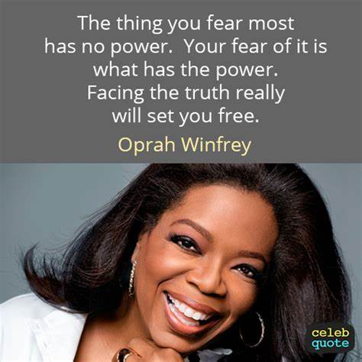
Inspiring Intentional Inclusion
Be accountable
Build your confidence and step up
. . . STOP MAKING EXCUSES!

Slide 4
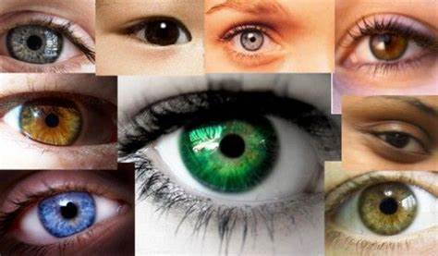
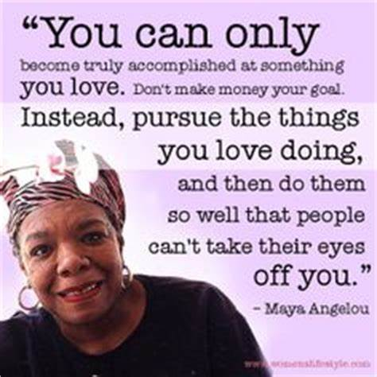
Inspiring Intentional Inclusion
Be accountable
Be your authentic self
Have the courage to make necessary changes
Love what you are doing; don’t make it about the money

Slide 5
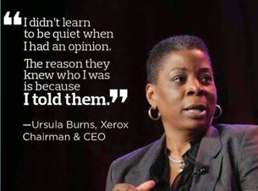
Inspiring Intentional Inclusion
Be accountable
Continue to enhance your professional skills (both soft skills and technical skills)
Raise your hand for new opportunities
Speak up!!!

Slide 6
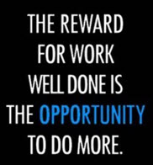
Inspiring Intentional Inclusion
Be accountable
KNOW YOUR ORGANIZATION’S BUSINESS
Don’t wait for someone to tell you; do your own research
Let your work speak for itself
Hard work doesn’t have to be witnessed; time exposes everything

Slide 7
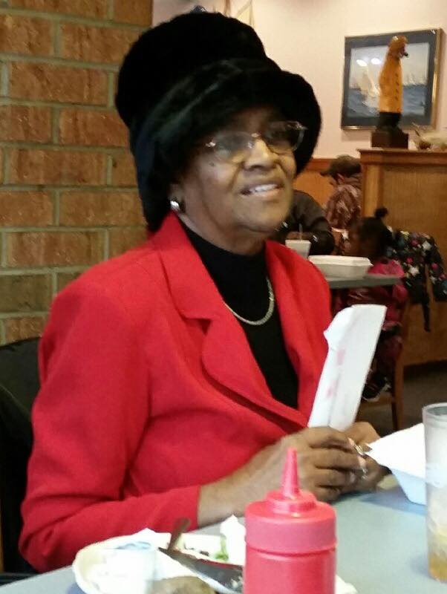
Inspiring Intentional Inclusion
Make sure you have a Mentor and A Sponsor:
Mentor
Someone internal or external to the organization who:
Has experience in your position of interest
Has credibility
Is able to provide guidance on a regular basis
Is willing to provide candid feedback
Is there for you during the good times and the bad

Slide 8
Inspiring Intentional Inclusion
Make sure you have a Mentor and A Sponsor:
Sponsor
Someone in the organization who:
Supports you and your desire for upward mobility
Gives you opportunities for development
Provides you face time with decision-makers
Gives you stretch assignments
Holds you accountable
Gives you candid feedback

Slide 9
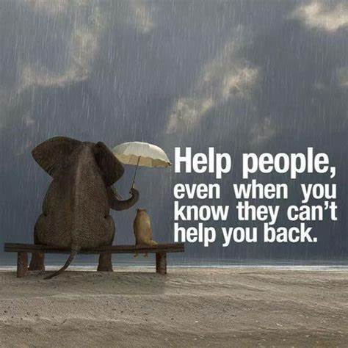
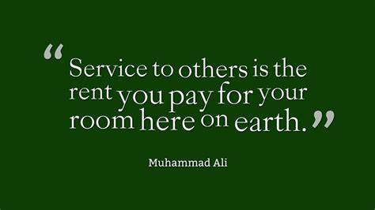
Inspiring Intentional Inclusion
Pay it forward!!!
By helping others, we help ourselves
Get involved and stay involved
Develop lasting relationships

