Slide 1
Mindfulness for life
NFBPA Session
April 2018 Helena Kriel, MA, ERYT, YACEP, EDD candidate
Member of Cigna’s Mindfulness-Oriented Stress Solutions Committee

Slide 2
Mindfulness for Life agenda
Mindfulness definition and benefits
Quick shifts: Techniques that work on the go
Mindful movement: Sensation and choice
Mindful Eating: What changes?
s
Confidential, unpublished property of Cigna. Do not duplicate or distribute. Use and distribution limited solely to authorized personnel. © 2016 Cigna
Notes:
Reiterate the definition

Slide 3
What is mindfulness?
“[T]he ability to be present, attentive, and curious, and to adopt a ‘beginner's mind’ with the goal of achieving greater awareness and insight into one's own work.”
--University of Rochester Medical Center
“By observing your mind, you realize you don't have to be slave to it.
You realize it throws tantrums, gets grumpy, jealous, happy and sad,
but that it doesn't have to run you…. We can't control what happens
on the outside but we do have a say
over the quality of our mind.”
--Emma M. Seppälä Ph.D.
The definition of mindfulness
continues to expand and evolve.
Confidential, unpublished property of Cigna. Do not duplicate or distribute. Use and distribution limited solely to authorized personnel. © 2016 Cigna
Notes:
Reiterate the definition

Slide 4
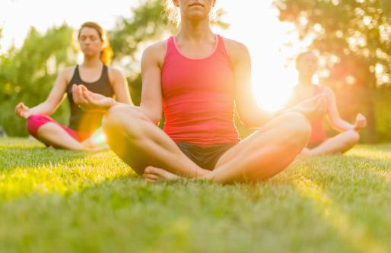
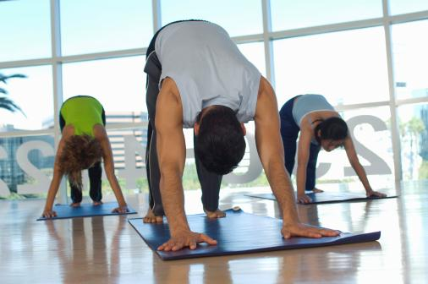
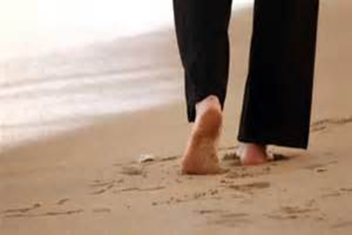
Mindful practices
Formal
Informal
Confidential, unpublished property of Cigna. Do not duplicate or distribute. Use and distribution limited solely to authorized personnel. © 2016 Cigna

Slide 5
Organizations with mindfulness programs
Confidential, unpublished property of Cigna. Do not duplicate or distribute. Use and distribution limited solely to authorized personnel. © 2016 Cigna
Notes:
Go thru the points

Slide 6
Mindfulness practice can improve:
Biometrics and immunity
Ability to recover from stress
Clear decision making, even under pressure
Team and individual performance
Productivity
Perception of pain
Window of tolerance
“Three seconds”: A moment of sensing or thinking before speaking
…and more!
Confidential, unpublished property of Cigna. Do not duplicate or distribute. Use and distribution limited solely to authorized personnel. © 2016 Cigna

Slide 7
MINDFULNESS ON THE GO:
Quick Techniques That Work
Confidential, unpublished property of Cigna. Do not duplicate or distribute. Use and distribution limited solely to authorized personnel. © 2016 Cigna

Slide 8
Mindfulness at work techniques: When you need a quick shift
Focal point awareness
Breathing: 3—7 breaths with a technique
Pick a sensation
Notice environment
Cognitive shifts
Which one might you use? When?
Confidential, unpublished property of Cigna. Do not duplicate or distribute. Use and distribution limited solely to authorized personnel. © 2016 Cigna

Slide 9
Focal-Point Awareness
Hold eyes on
a point
Allow vision
to expand
Slow
breathing
Confidential, unpublished property of Cigna. Do not duplicate or distribute. Use and distribution limited solely to authorized personnel. © 2016 Cigna
Notes:
Reiterate the definition

Slide 10
Breathing techniques
Square breathing: Balance
“O” breath: Reduce cravings and impulsivity
Right-to-left breathing: Energizing, confidence
Left-to-right breathing: Calming, stability
Awareness of breath moving
Confidential, unpublished property of Cigna. Do not duplicate or distribute. Use and distribution limited solely to authorized personnel. © 2016 Cigna

Slide 11
Find a sensation: Orient to the present
Breath
movement
Wiggle
toes
Find a
Sensation
Squeeze
bicep
Shift in
seat
Confidential, unpublished property of Cigna. Do not duplicate or distribute. Use and distribution limited solely to authorized personnel. © 2016 Cigna

Slide 12
Temperature
Size
Pressure
Color
Mini
Mindful
Tracker
Movement
Number
Sound
Distance
Confidential, unpublished property of Cigna. Do not duplicate or distribute. Use and distribution limited solely to authorized personnel. © 2016 Cigna

Slide 13
Mindfulness and cognition: Change your mind state quickly
With a thought that is causing problems or suffering…asking, “Is it true?”
Finding a gratitude
Finding a gratitude within the situation
Which one might you use? When?
Confidential, unpublished property of Cigna. Do not duplicate or distribute. Use and distribution limited solely to authorized personnel. © 2016 Cigna

Slide 14
Expressing gratitude improves:
Feelings of joy and happiness
Generosity, altruism and compassion
Resiliency
Relationships
Anxiety and depression
Physical health
Sleep
Confidential, unpublished property of Cigna. Do not duplicate or distribute. Use and distribution limited solely to authorized personnel. © 2016 Cigna
Notes:
Reiterate the definition

Slide 15
MINDFUL MOVEMENT
Confidential, unpublished property of Cigna. Do not duplicate or distribute. Use and distribution limited solely to authorized personnel. © 2016 Cigna

Slide 16
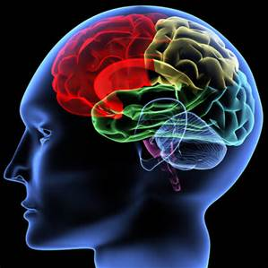
How does extreme stress affect brain function?
Diminished ability to focus on the present
Trouble regulating emotions
Trouble regulating heart rate
Constrains on capacity to communicate
Amygdala may be overactive
Medial prefrontal cortex may be underactive
Movement can help your brain recover.
Confidential, unpublished property of Cigna. Do not duplicate or distribute. Use and distribution limited solely to authorized personnel. © 2016 Cigna

Slide 17
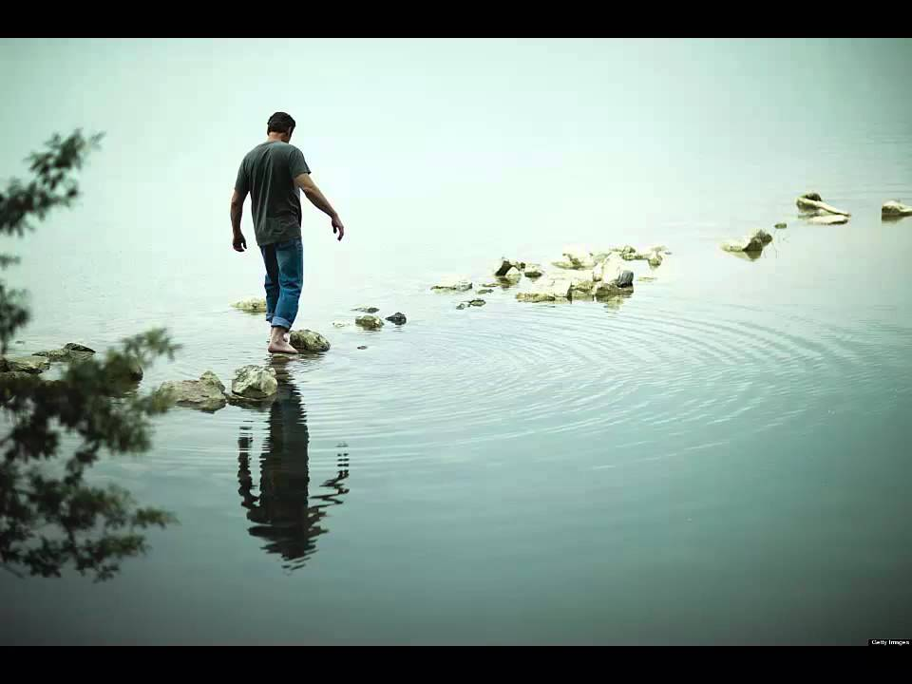
Movement Practice
Confidential, unpublished property of Cigna. Do not duplicate or distribute. Use and distribution limited solely to authorized personnel. © 2016 Cigna

Slide 18
Movement Mindfulness
Using interoception, choice-making, and
present-moment awareness to decrease stress
Which elements resonated most for you?
Present Moment
Choice
Sensation
Movement
Confidential, unpublished property of Cigna. Do not duplicate or distribute. Use and distribution limited solely to authorized personnel. © 2016 Cigna
Notes:
Reiterate the definition

Slide 19
MINDFUL EATING
Confidential, unpublished property of Cigna. Do not duplicate or distribute. Use and distribution limited solely to authorized personnel. © 2016 Cigna

Slide 20
Eating or drinking mindfully
Choose a food or drink
1
Pause to see if you want more
4
2
Notice shape,
scent, texture,
size, origins
3
Notice taste, temperature,
“mouth feel”
Confidential, unpublished property of Cigna. Do not duplicate or distribute. Use and distribution limited solely to authorized personnel. © 2016 Cigna

Slide 21
Resources
Organizations
Mindful.org/at-work
Umassmed.edu/cfm/stress-reduction
Guided meditations
Jon Kabat-Zinn: www.mindfulnesscds.com
Free audio: www.marc.ucla.edu/body.cfm?Id=22
Coach by Cigna: Download from app store or goggle play store
Books
Mindfulness for beginners: Reclaiming the present moment and your life by Jon Kabat-Zinn
The miracle of mindfulness: An introduction to the practice of meditation by Thich Nhat Hanh
Finding the space to lead: A practical guide to mindful leadership by Janice Marturano
Youtube videos
Mindfulness as an approach to improving performance by Dr. Jutta Tobias
What is mindfulness? By John Kabat-Zinn
Mindfulness over matter by Dr. Ellen Langer

Slide 22
Questions?
Comments?
Thank you!
Confidential, unpublished property of Cigna. Do not duplicate or distribute. Use and distribution limited solely to authorized personnel. © 2016 Cigna

Slide 23
All Cigna products and services are provided exclusively by or through operating subsidiaries of Cigna Corporation, including Cigna Health and Life Insurance Company, Connecticut General Life Insurance Company, Cigna Behavioral Health, Inc., and HMO or service company subsidiaries of Cigna Health Corporation. The Cigna name, logo, and other Cigna marks are owned by Cigna Intellectual Property, Inc.
900181 08/16 © 2016 Cigna. Some content provided under license.

