Slide 1
NFBPA Presentation
2019

Slide 2
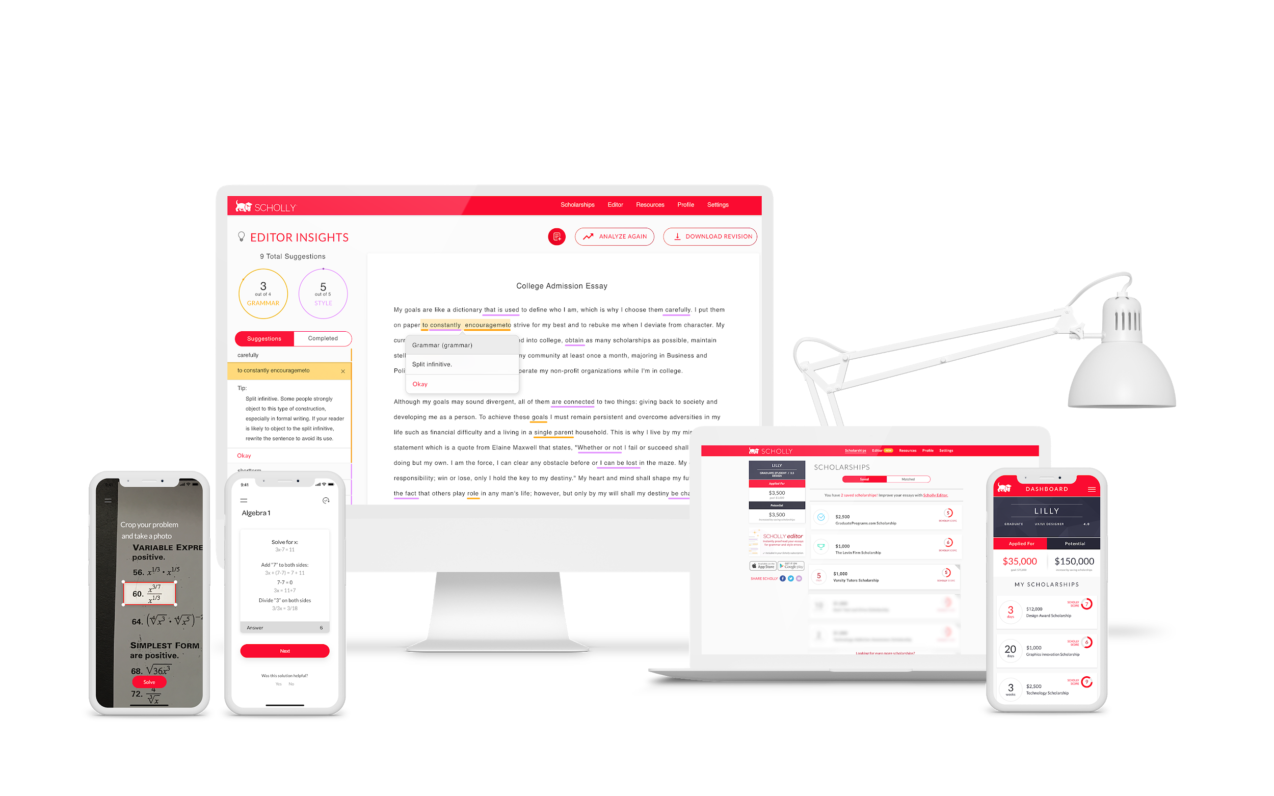
Opportunity for all
After winning $1.3 million in scholarships, Christopher Gray founded Scholly, an app that helps students easily find scholarships for college.
Scholly was featured on ABC’s Shark Tank, landing a deal with Daymond John and Lori Greiner.

Slide 3
Scholly Impact
We’re creating access to higher education for all:
$100+ Million
3+ Million Users
130+ Organizations
$100+ Million won in scholarship awards through our search platform
The mobile & web platforms currently supports over 3+ Million Users
Our Give Scholly Program has helped 130+ Organizations provide financial access to their students

Slide 4
Press
From a Product to a Movement

Slide 5
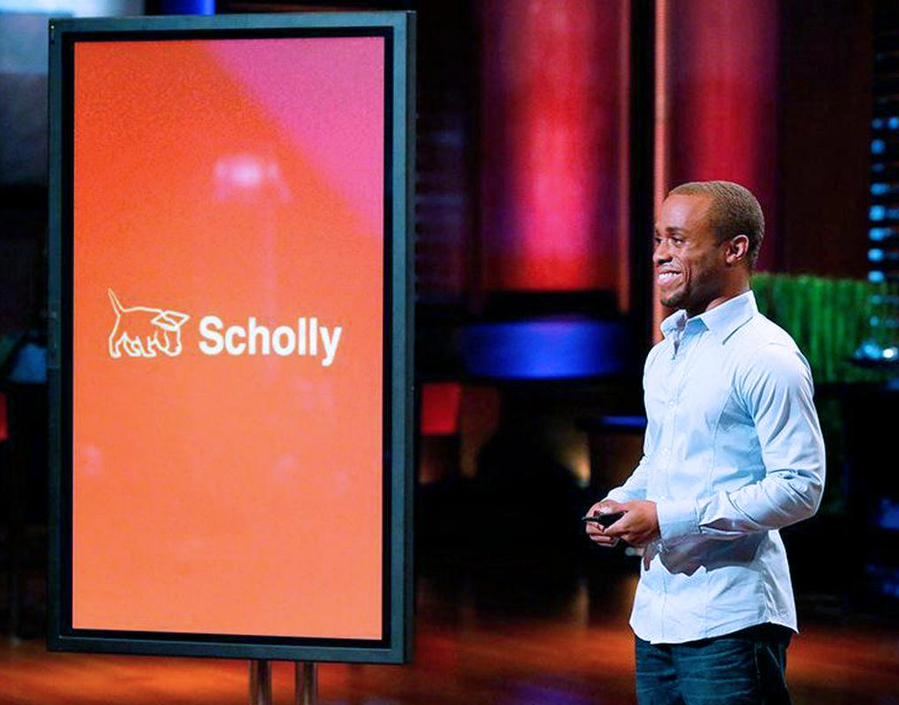
Scholly has been featured on ABC’s Shark Tank
Landed a deal with Daymond John & Lori Greiner
Started the biggest fight in Shark Tank history
One of the highest rated episodes

Slide 6
Season 6, Episode 20

