Slide 1
The Effects of PTSD in Public Safety
Kevin V. Preston
Assistant Chief
Orlando Fire Department

Slide 2
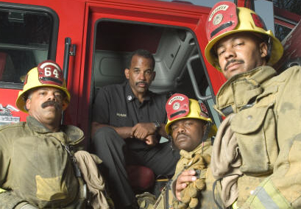
Focus of Presentation
This presentation will focus on the various factors leading to PTSD in emergency responders
Investigate the possibility of early intervention, as well as what can be done to help limit the occurrences and/or severity of symptoms

Slide 3
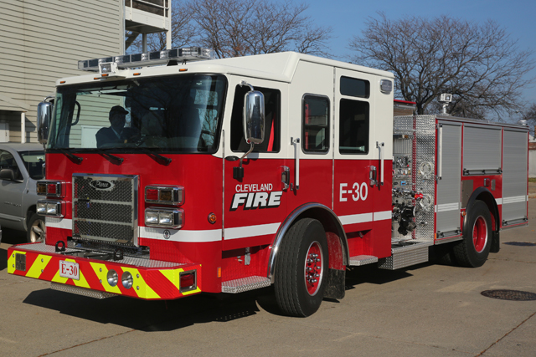
Keywords
Post-traumatic Stress Disorder (PTSD)
Post-traumatic Stress Symptomology (PTSS)
Compassion Fatigue or Burnout

Slide 4
Statistics
Prior to 9/11, PTSD was generally associated with those military personnel returning from theaters of war or conflict or were otherwise victims of violent crimes, like domestic abuse or abduction
Up to 88% of emergency workers have experienced at least one traumatic event during their professional careers
Diagnosed cases of PTSD range from 10-14% in this field

Slide 5
Statistics
First Responders more likely to die from suicide than in line of duty
A mental health study preformed by Ruderman Family Foundation, cited PTSD and depression stemming from exposure to trauma as factors that contributed to the higher-than-usual suicide rates.
A survey of first responders
found that 6.6 percent had attempted suicide,
which is more than 10 times the rate in
the general population
Notes:
http://www.nydailynews.com/news/national/responders-die-suicide-job-article-1.3930162
New York Daily news article - In 2017, at least 103 firefighters and 140 police officers took their own lives, compared to the 93 firefighters and 129 police officers who died in the line of duty, the Ruderman Family Foundation reports.
The mental health study cited PTSD and depression stemming from exposure to trauma as factors that contributed to the higher-than-usual suicide rates.
https://www.firerescue1.com/fire-ems/articles/222673018-Increasing-suicide-rates-among-first-responders-spark-concern/ (SURVEY)

Slide 6
Factors Leading to PTSD
Emergency Workers (police officers, fire fighters, rescue and disaster workers, military personnel and ambulance personnel, are at a higher occupational risk of developing posttraumatic stress disorder (PTSD) owing to their repeated exposure to critical incidents
Notes:
https://www.ncbi.nlm.nih.gov/pmc/articles/PMC4004503/

Slide 7
Factors Leading to PTSD
Critical incidents are events involving death, life-threatening injury or a crisis situation with a need for rescue or emergency that may result in stress-related reactions and the development of PTSD. The mental health of Emergency Workers may be compromised by the nature of their work, which can be compounded by shorter recovery times
Notes:
https://www.ncbi.nlm.nih.gov/pmc/articles/PMC4004503/

Slide 8
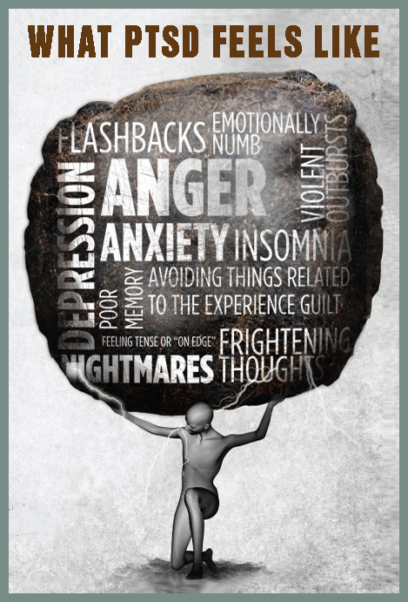
Factors Leading to PTSD
Comorbidity - the simultaneous presence of two chronic diseases or conditions
For example, in a UK study, researchers found that 10% of the 574 emergency medical care workers included in their study were suffering from clinical levels of depression and 22% met PTSD criteria.
Co-morbidity with depression may work bi-directionally, both as a possible pre-existing mediator for PTSD and also as a consequence or indirect effect of PTSD.
Notes:
https://www.ncbi.nlm.nih.gov/pmc/articles/PMC4004503/
Comorbidity is another factor that may predispose ECW to subsequent PTSD. For example, in a UK study, researchers found that 10% of the 574 emergency medical care workers included in their study were suffering from clinical levels of depression and 22% met PTSD criteria [10]. Depression can also follow a traumatic event. For example, one study found that 16% of emergency personnel present at the scene of a tragic aeroplane crash were diagnosed with depression seven months after the incident [11]. Co-morbidity with depression may work bi-directionally, both as a possible pre-existing mediator for PTSD and also as a consequence or indirect effect of PTSD. In addition, high risk alcohol and drug use is positively correlated with PTSD symptomatology [12].

Slide 9
Interventions
Military mental health screening model: before deployment, while in the field, and then upon return from assignment
Municipalities are responsible for the training and protection of the employees that serve the community.
Culture shift and stigmatization of mental illness
Support systems / increase access to mental health professionals

Slide 10
Challenges
Challenges in recognizing the issues include misdiagnosis or cases going undiagnosed because all of the symptoms aren’t shown
Jurisdictions attempting to balance the need for mental help and the associated costs
The Ethical Scope – fix versus funding
Notes:
Handling PTSD on a case by case basis is better for the bottom line even though it is not the most ethical approach to those being continually exposed to this type of stressors in the workplace
If the average municipality were to provide training to every public safety worker, this might keep the individual costs of a PTSD claim down, but will likely increase the financial burden on the tax payers and other employees as insurance premiums are adjusted – ethics versus funding

Slide 11
A deeper issue?
With the continued decline of nuclear support networks (i.e. family, faith based communities) it appears that the responsibility of providing the support previously found in these places is now falling to the non traditional institutions, with an associated financial cost element.
Is this similar to the issues being faced within the school system? …where teachers are more largely playing the role of parent or disciplinarian, with less and less focus on the job they are actually there to do…teach.

Slide 12
Summary
Emergency responders face stressful situations regularly and are usually very capable of suppressing their feelings and emotions while on the scene
Through the research conducted in the various studies and articles selected for this review, it was largely understood that emergency responders fare better when their mental health is a priority of those who employ them
Healthy, safe work environments that include management support, shared decision making, and recognize the contributions of those who give so much every day can lead to increased responder retention, reduced staff turnover, and increased job satisfaction

