Slide 1
Socially Responsible Impact Financing Innovative Approaches to Tackling Social and Educational Challenges

Slide 2
Agenda
Private Dollars/Public Priorities
Social Impact Bonds – An Overview
Social Impact Bonds - Challenges
Federal Funding Opportunities – SIPPRA
The Challenge of Female Incarceration in Oklahoma
The Pay for Success Approach in Oklahoma
FAQs
Initial Outcomes
Question and Discussion

Slide 3
Private Dollars/Public Priorities
Spending on discretionary social and justice programs has generally not kept up with need as entitlement costs continue to rise
This has led governments to look to private sources for financial assistance and program innovation
Private Sources and Methods
“Impact Investing”
Microfinance
Social Impact Bonds
Pay for Success/Pay for Performance
Examples of Participating Philanthropic Organizations
Bloomberg Philanthropies
Arnold Foundation
This Photo by Unknown Author is licensed under CC BY
Notes:
Bloomberg Philanthropies – Public Health, Government Innovation, Education
Arnold Foundation - Criminal Justice, Education, Health, Public Finance, Research, and Evidence-Based Policy

Slide 4
Social Impact Bonds – An Overview
Genesis – Pioneered in the United Kingdom in 2010, the idea quickly spread to the United States (2012) and other industrialized economies to address issues like recidivism, drug treatment, job placement
Concept (taken from: https://www.thirdsectorcap.org/what-is-pay-for-success/):
Government defines problem
Funders provide capital
Provider delivers
Evaluator determines success
Government pays for success
Notes:
Government defines a difficult social problem
Private funders provide upfront capital to enable a results-oriented social services provider to address the problem
The social services provider designs and delivers a program to address the difficult social problem
An independent evaluator determines whether the program has achieved demonstrably better results than a control group
The government pays back the investors (with profit) if and only if the target level of improvement is achieved

Slide 5
Social Impact Bonds – Challenges to Date
Novelty - Governments have a hard time doing this because it’s different from standard contracting practices. For example, it often requires future legislative action to fund results-based payments after a program has demonstrated results. It requires significant, on-going coordination between the chief executive, procurement, contract monitoring, and the legislature.
Optics – Some object to investors receiving a payment (and, especially, a profit) for something that “government is supposed to be doing in the first place”.
Risk – For investors, early programs have shown that the amount of risk is much greater than was originally thought. Replicating a successful process to get the previously-demonstrated outcomes in the new situation doesn’t always work. Measurement of success by a third party firm is not perfectly objective process either – adding to the risk.

Slide 6
Federal Funding Opportunities
The Social Impact Partnerships to Pay for Results Act (SIPPRA) was signed into law on February 9, 2018 and is intended to improve the effectiveness of certain social services. The federal government will pay for a project only if predetermined project outcomes have been met and validated by an independent evaluator.
The SIPPRA notice of funding availability was released February 22, 2019, which provides for local governments to develop social impact partnerships, including pay for success projects.
Only state and local governments may apply. Applications are due May 22, 2019.
Congress appropriated $100 million for the SIPPRA program to implement “Social Impact Partnership Demonstration Projects” and feasibility studies to prepare for those projects.

Slide 7
Some Examples of SIPPRA Outcomes
Increasing earnings and work by individuals in the United States who are unemployed for more than 6 consecutive months.
Increasing employment and earnings of individuals who have attained 16 years of age but not 25 years of age.
Increasing employment among individuals receiving Federal disability benefits.
Reducing the dependence of low-income families on Federal means-tested benefits.
Improving rates of high school graduation.
Reducing teen and unplanned pregnancies.
Other measurable outcomes defined by the state or local government that result in positive social outcomes and Federal savings.

Slide 8
The Challenge of Female Incarceration in Oklahoma
“In 2016, Oklahoma continued to lead the nation in female incarceration – a dubious distinction the state has owned for more than 25 years.” - State of Oklahoma Dept. of Corrections (ODOC), 1/13/2018
Many women are in prison for nonviolent offenses such as for drugs and drug-related crime, even simple possession – Public Radio International, 2/13/2019
A 2016 voter-approved ballot measure reducing drug possession from a felony to a misdemeanor has so far done little to stem the flow of inmates into Oklahoma prisons for that crime – The Oklahoman, 3/26/2018
Through 2018, little had been done in the legislature to promote sentencing reform, although new governor Kevin Stitt has now made it a priority. – The Journal Record, 2/7/2019
Notes:
OK rate is 149/100,000.
Next nearest is 115/100,000.
Average is 64/100,000.

Slide 9
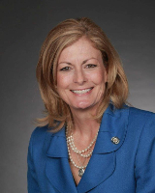
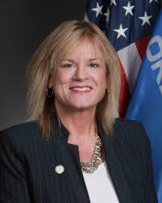
The OK Pay for Success Partners
Notes:
The Legislators
Senate Appropriations Committee chair Kim David
Representative Leslie Osborne
The Provider – Family and Children Services (Women in Recovery
The Funder – George Kaiser Family Foundation
Agencies
Department of Corrections
Office of Management and Enterprise Services

Slide 10
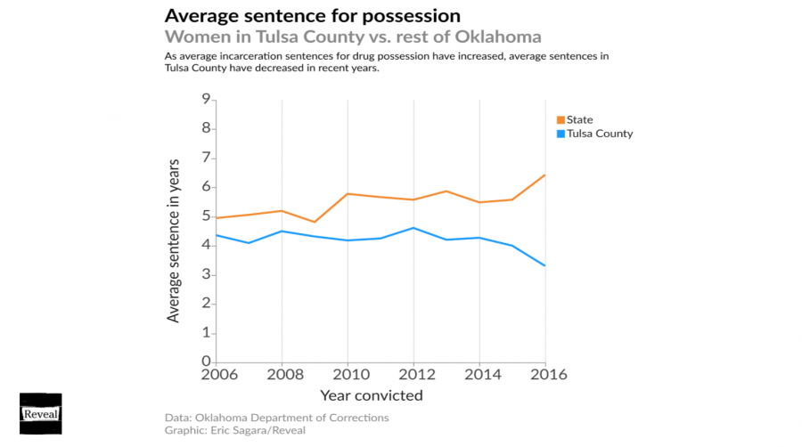
Women in Recovery - A Previous Record of Success
From the Center for Investigative Reporting - https://www.revealnews.org/article/let-down-and-locked-up-why-oklahomas-female-incarceration-is-so-high/

Slide 11
Pay for Success Project Design in Oklahoma
Proven Approach - In April 2017, the State of Oklahoma (State) and Tulsa-based Family & Children’s Services (F&CS) entered into a Pay for Success contract aimed at reducing Oklahoma’s female incarceration rate by securing public-private investment in the successful Women in Recovery (WIR) prison diversion program. This project enabled WIR to expand its existing services, admitting up to 125 women into the program annually for up to five years.
Success-Only Payments - Success is simply defined as a WIR program participant not being incarcerated within an Oklahoma Department of Corrections (DOC) facility. The total potential payment amount received by F&CS at four different milestones for each successful outcome is considerably less than the total average cost of incarceration for a woman at a DOC facility over the average length of stay ($30,133). Other savings that the state achieves for each successful participant include those resulting from improved education, employment, health, and children’s life outcomes and reduced reliance on social benefit programs.
Notes:
Women in Recovery was founded in 2009.

Slide 12
FAQs
How is a WIR’s eligibility determined?
How is success measured?
Is this program operating in Tulsa County only?
How will the State oversee the program?
Is the State just taking over an already privately funded program?
How does the program leverage private funding?

Slide 13
Initial Outcomes
State support has allowed for a doubling of the program – there are 196 women in the model now and the number is rising
18 of the newly-funded participants have graduated
0 have recidivated
The legislative appropriations to fund the initial success payments have been made
Success payments to Family and Children are being made

Slide 14
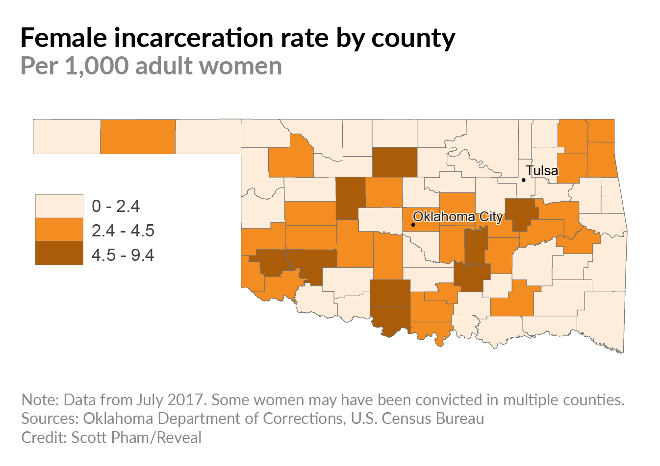
Women in Recovery – Continued Success
From the Center for Investigative Reporting - https://www.revealnews.org/article/let-down-and-locked-up-why-oklahomas-female-incarceration-is-so-high/

Slide 15
Ripple Effects in Oklahoma
Explicit support from the new governor, Kevin Stitt, in the State of the State speech
The Oklahoma legislature is actively considering additional Pay for Success funding, including to fund proven substance abuse treatment programs for women to further reduce the state's incarceration rates
Other Oklahoma-based philanthropies have expressed interest in funding similar programs elsewhere in the state
“This Pay for Success program has moved the state towards prioritizing outcomes versus units of service.”
- Amy Santee, GKFF

Slide 16
Internet Resources – Pay for Success
Topic | Website
Davenport & Company | https://www.investdavenport.com/
Faegre Baker Daniels | https://www.faegrebd.com/en
Pay for Success | https://www.payforsuccess.org/
Third Sector Capital | https://thirdsectorcap.org
US Treasury SIPPRA Information | https://home.treasury.gov/services/social-impact-partnerships/sippra-pay-for-results
Urban Institute | https://pfs.urban.org/library/pfs-projects-glance
Family and Children’s Services | https://www.fcsok.org/
George Kaiser Family Foundation | http://www.gkff.org/

Slide 17
Questions & Discussion
Questions & Discussion

