Slide 1
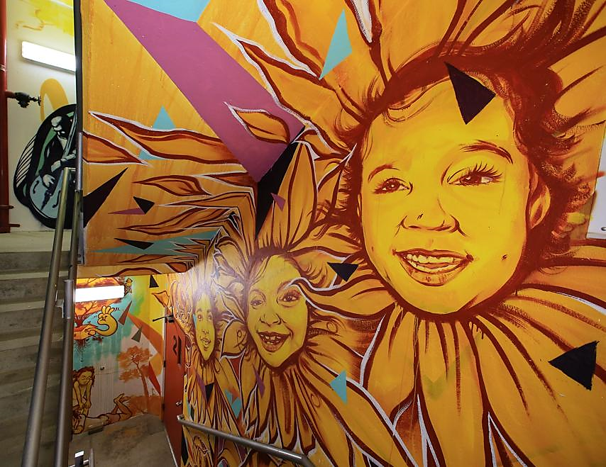
HIV/AIDS Education: It Takes a Village to Reach Our Youth
Angela d. Smith,
small business Development specialist ii
Palm beach county
Office of small business assistance

Slide 2
It takes a village (to raise a child)
An African-Proverb that has been said to have originated from Nigeria, but utilized throughout many African nations, as well as Western Culture African-American communities . It means “to invoke blessings from God”
Notes:
I have chosen this title because that proverb can be applied to ensuring the health and well-being of the children in our communities.

Slide 3
HIV Infection Cases
In Palm Beach County,
HIV cases in 2016 increased to 44.1% from the previous year’s 29.6% in Non-Hispanic Black males
Non-Hispanic Black females showed a decrease to 7.2% from the previous year’s 29.4%
Notes:
In 2016 there were almost 40,000 new HIV diagnoses in the United States; around 32,000 were adult and adolescent males (13 years and older). Over 7,500 were adult and adolescent females within the same age range, over 100 were children younger than 13 years of age.

Slide 4
Goal and Objective
Provide a broad assessment of current HIV/AIDS awareness and prevention programs offered to African American youth, ages 13 to 19:
Local Government
Local School District
Faith-based/non-profit organizations, and
Parental/Guardian Involvement
Notes:
My goals for my individual project was to review current programs in Palm Beach county specifically for youth offered by Government agencies, school districts,

Slide 5
Goal and Objective
Review statutory expectations and funding guidelines and compare to how programs are being implemented
Evaluate program accessibility to African American youth
Render suggestions for possible improvements

Slide 6
Local Government Programs
Palm Beach County Youth Services Department
Palm Beach County Department of Health and Human Services

Slide 7
Local Government Programs
Palm Beach County Youth Services Department
Serves as a funding source and monitor for non-profit community
agencies
Planned Parenthood of South Florida
Compass, Inc.
Notes:
Planned Parenthood offers a program, funded by Palm Beach County Youth Services called “Time for your Teen” this program is a 4 session course for identity. The targeted communities are predominately Black and Hispanic. They have an annual contract with Youth Services for $49,600 parents/caregivers and their teen to have open conversations about sex, sexually transmitted disease/HIV education, pregnancy education and prevention, and sexual . Their progress is measured by the amount of parents/caregivers sign up for the sessions and a survey of their increased knowledge and communication skills.
Compass, Inc. Is another local non-profit agency that caters specifically to the LGBTQ community. They are also funded by Youth Services for their Transgender Support Group. The funding from PBC YSD allows them to work with transgender/non binary youth and educating the community and its youth to prevent and reduce the spread of HIV/STIs and STDs.

Slide 8
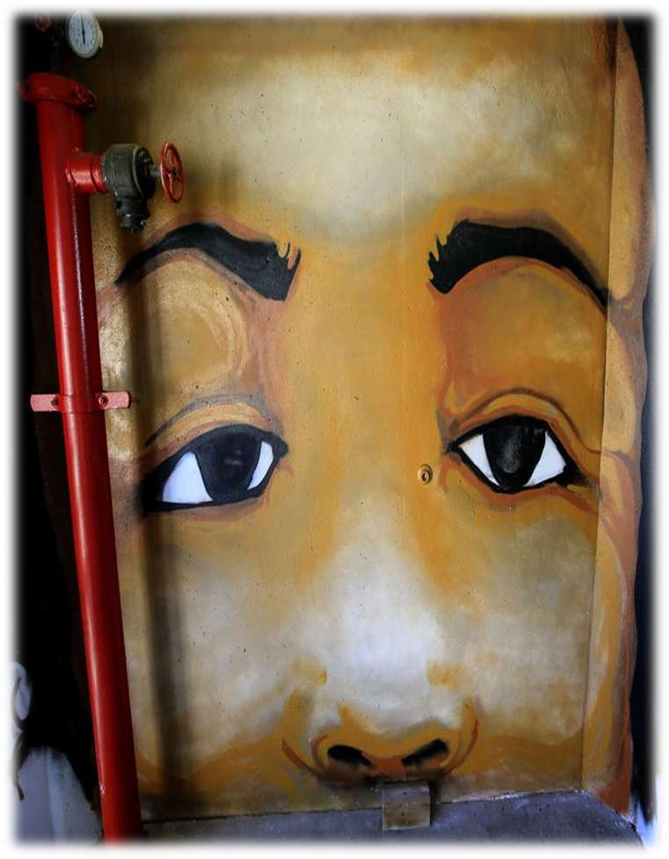
Local Government Programs
Palm Beach County Department of Health
Statutorily mandated to provide and oversee education and prevention of HIV/STD/STI and AIDS
Serves as a funding source for local non-profit agencies
FoundCare, Inc.
Notes:
Under their Communicable Diseases and Epidemiology unit, they focus on the prevention and control of the spread of communicable diseases, through classes and education information disseminated at public outreach events.
Florida Statute Title XXIX, Chapter 381
FoundCare – is a nonprofit organization that utilizes their funding to education and provide free HIV testing in predominately African American and Hispanic communities in Palm Beach County.

Slide 9
Palm Beach County School District
Florida School Districts are statutorily mandated to provide instructional time toward the education on AIDS and other STD, STI diseases.
The curriculum is solely abstinence based
Educational time is primarily at the end of the year, after core class testing
PBCSD Parents have an “opt-out” request for their child. However, the parent has to initiate the request, it is not readily offered to them.
Notes:
Florida Statutes, Title 48, Chapters1003.42 and 1003.46 are the laws that govern school districts in Florida on required instruction and health education instruction in acquired immune deficiency syndrome (AIDS)

Slide 10
Faith Based Organizations
Although the church’s primary principle as it relates to sex is abstinence, during nationally recognized observation days, such as World AIDS Week, clergy come together and partner with local non-profits such as a FoundCare and Planned Parenthood to assist in the education and prevention of HIV/AIDS.
Building/Parking lots are used to host
Offer prayer and counseling to families
Participate in events throughout the week
Nothing specifically geared toward youth (13-19)
Notes:
In 2017, during the World AIDS week long observation, pastors and clergy from predominately African American community churches participated in prayer vigils for families who have lost their loved ones to the disease. They provided their building and/or parking lot areas as a hub for testing, providing literature and condom distribution.

Slide 11
Parental/Guardian Involvement
Ten (10) Parents/Guardians/Caregivers were surveyed to inquire about their knowledge and communication skills on the topic of sex, HIV/AIDS and STD/STI.
70% were unaware of the high numbers of HIV diagnoses of individuals ages 13-24.
70% were aware that Palm Beach County Schools are bound by law to utilize age appropriate curriculum on HIV/AIDS/STD and risky behavior awareness.
30% were unaware of programs and community events centered around HIV/AIDS/STD education
60% were not interested in finding out how they could get more information
Notes:
Parents were from various racial/ethnic, socioeconomic, and family structure households who reside in Palm Beach County. The survey was entitled “The Talk”.

Slide 12
The Village Impact
Programs ARE offered through Government and Non-profit agencies
Only to those who inquire
Education and Information are readily accessible
Only to those who are in the right place at the right time
Parents do communicate with their children
Will only allow educators to provide additional information
Faith based organizations will extend assistance
Only in limited capacities
Notes:
As a result of my broad assessment of the programs offered by the four (4) entities mentioned earlier in the presentation, it appears as though statutory mandates local/state health agencies and school districts, as well as properly/generously funded agencies are providing different levels of education. Most parents will only allow the limited school curriculum to further educate their kids on HIV/AIDS. Faith based organization do their part by allowing the space for non-profit agencies to come in for the community as a whole, but nothing is provided for the youth. While non-black churches provide programs and events surrounded by abstinence and the dangers of promiscuity, there is no indication that predominantly attended black churches provide those same events.

Slide 13
Program Assessment
Current programs funded and provided by government and non-profit agencies are readily available to African American youth.
However, African American parents and the churches in the black community can collaborate a little more with the existing programs that uphold moral values, while educating on the dangers of promiscuity.
Notes:
Programs that are available to young adults are fun, innovative, and strategic in nature, creating a great response, which in turn could possibly reduce the number of infections in that age group (20-25). However, with the middle school / high school teenagers, it would be challenging to mirror that type of program, since they are still under the supervision of their parents.

Slide 14
Questions

