Slide 1
Wicked Problems and Wise Cities:
Building Capacity for Deliberative Engagement in a VUCA World
Martín Carcasson, Ph.D.
Director of the Center for Public Deliberation
Professor, Department of Communication Studies
Dedicated to enhancing local democracy through improved public communication and community problem solving
EMAIL: mcarcas@colostate.edu
Twitter: @mcarcasson CPD website: cpd.colostate.edu

Slide 2
Which statements best describe your view of the current quality of public discussion and debate? (choose up to three)
High quality, informed
Mean-spirited
Polarized
Involves a broad range of voices
Simplistic
Dominated by a few loud voices
Dominated by experts
Robust
Weak/limited, people are apathetic
(press 0) Productive

Slide 3
CPD Projects, 2006-2018
Civic mission of schools
Grade configuration of Poudre School District schools
Statewide dropout rate
Colorado Health Care Reform
Student housing
Improving higher education
Childhood obesity
Bicycle safety
Diversity Dialogues at CSU Diversity Conference
STEM education in K-12
Arts Engagement Summit
UniverCity Connections (CSU/Old Town collaborative project)
School budgeting issues/school closures
Medical Marijuana
Regional visioning process
Water and growth issues
Poverty in Larimer County
PSD Student Think Tank facilitator group
K-12 school improvement
Improving higher education through student-faculty reciprocity
Politics of food
Issues surrounding aging
Early childhood education
On campus stadium proposal
Senior transportation
Campus smoking
School safety
Bullying
Mental health
Nature in the City
Larimer County Landfill/Wasteshed
Diversity and Inclusion in Fort Collins
CSU Innovation and Economic Prosperity
CSU parking and affordable housing

Slide 5
Applications to Municipalities
Multiple Levels of Communication
Council Engagement
City Manager/Staff and Council
City Government and Community
Community Engagement

Slide 6
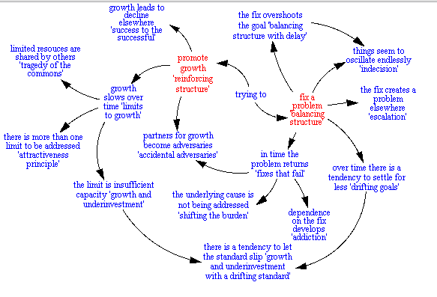
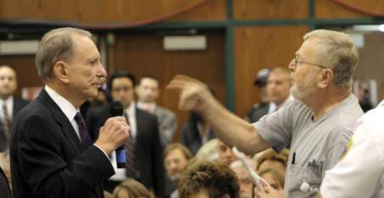
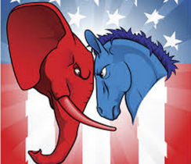
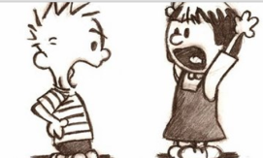
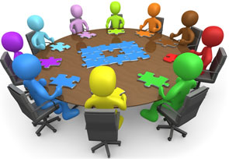
Overview: Three Key Arguments
#1 – The Basic Reality
Most of the key problems we face are best understood through a wicked problems lens
#2 – The Bad News
Human nature and many of our primary institutions and processes are woefully ill-suited to address wicked problems
#3 – The Hopeful News
Once we realize #1 and #2, we can build capacity for the kinds of conversations, processes, and institutions that cultivate the wisdom so critical to addressing wicked problems, particularly at the local level

Slide 7
Wicked problems inherently involve competing underlying values, paradoxes, and tradeoffs that cannot be resolved by science.

Slide 8
Key Deliberative Responses
Prioritizing
Balancing
Transcending

Slide 9
FOOD AS A WICKED PROBLEM
WE WANT OUR FOOD TO BE:
Inexpensive
Fresh
Nutritious
Safe
Long lasting
Delicious
Convenient
(Accessible, Easy to prepare)
Ethically grown
(labor/animal welfare)
Our choice
Supportive of a local economy
Supportive of a agriculture community
Grown and delivered in a environmentally responsible manner
Supportive of efforts to reduce hunger locally and globally

Slide 10
HEALTH CARE AS A WICKED PROBLEM
High Quality
Accessible
Low cost

Slide 11
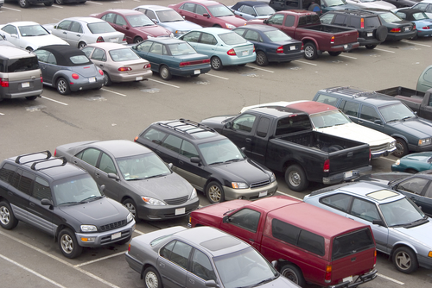
Parking at CSU as a Wicked Problem
Some things we care about:
Low cost
Fairness
Safety
Work productivity
Flexibility
Aesthetics/
Campus beauty
Convenience/
Low time cost
Low community impact/
Good neighbors
Employee morale
Environment
Consistency/Ease of use
Works for staff
Works for faculty
Works for visitors
Works for students
Works for working parents
Works for commuters

Slide 12
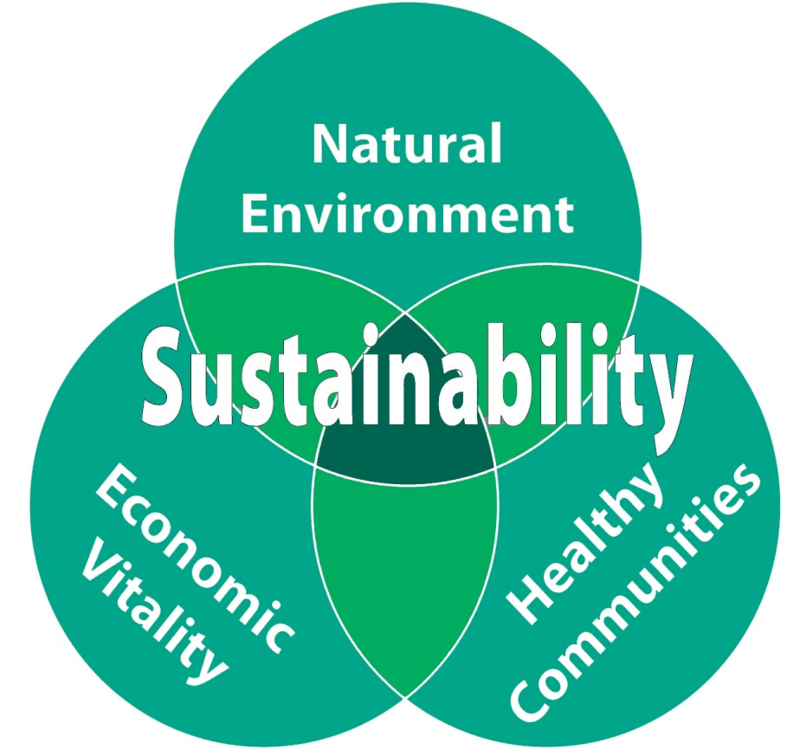
Capitalism or Sustainability as a Wicked Problem
The “Triple Bottom Line” of
Profit (economics, also tied to jobs and taxes)
People (social justice, equality, fairness)
Planet (environment)

Slide 13
We the People of the United States, in Order to form a more perfect Union, establish Justice, insure domestic Tranquility, provide for the common defense, promote the general Welfare, and secure the Blessings of Liberty to ourselves and our Posterity, do ordain and establish this Constitution for the United States of America.

Slide 14
We the People of the United States, in Order to form a more perfect Union, establish Justice, insure domestic Tranquility, provide for the common defense, promote the general Welfare, and secure the Blessings of Liberty to ourselves and our Posterity, do ordain and establish this Constitution for the United States of America.

Slide 15
Key American Values
Preamble | Current Phrasing
Justice | Justice
Domestic Tranquility/ Common defense | Security/Safety
General Welfare | Equality
Liberty to ourselves | Freedom (for us)
Liberty for our posterity | Freedom (for future generations)

Slide 16
Which is most important to you? (choose only one)
Justice
Security/safety
Equality
Freedom (for us)
Freedom (future generations)

Slide 17
Which is least important to you? (choose only one)
Justice
Security/safety
Equality
Freedom (for us)
Freedom (future generations)

Slide 18
Inherent Democratic Tensions
Freedom and Equality (and between equality and equity)
Our Freedom and Freedom of Future generations
Freedom and Security
Justice is a tension within itself (justice as the ideal between too much and too little credit or punishment)
Some others
Short term and long term
Individual rights and community good
Unity and diversity
Cooperation and competition
Structure and agency (or opportunity and individual responsibility)
Flexibility/Innovation and Consistency/Tradition
Best use of resources (money, time, people)

Slide 19
Wicked problems inherently involve competing underlying values, paradoxes, and tradeoffs that cannot be resolved by science.
They call for ongoing high quality communication, creativity, and broad collaborative action to manage well.
.

Slide 20
Overview: Three Key Arguments
#1 – The Basic Reality
Most of the key problems we face are best understood through a wicked problems lens
#2 – The Bad News
Human nature and many of our primary institutions are woefully ill-suited to address wicked problems
#3 – The Hopeful News
Once we realize #1 and #2, we can build capacity for the kinds of conversations, processes, and institutions that cultivate the wisdom so critical to addressing wicked problems, particularly at the local level

Slide 21
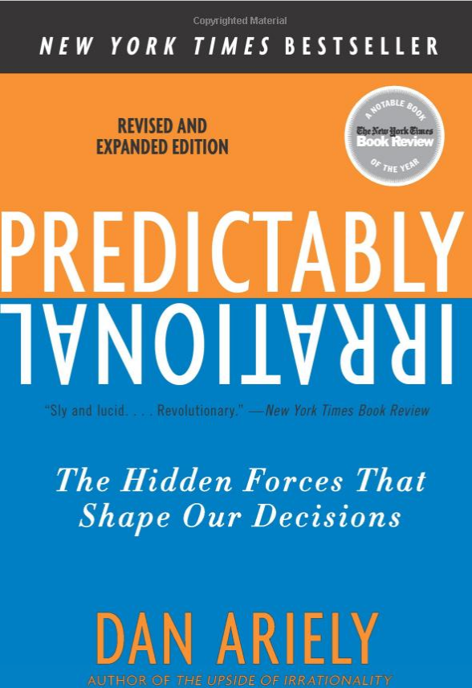
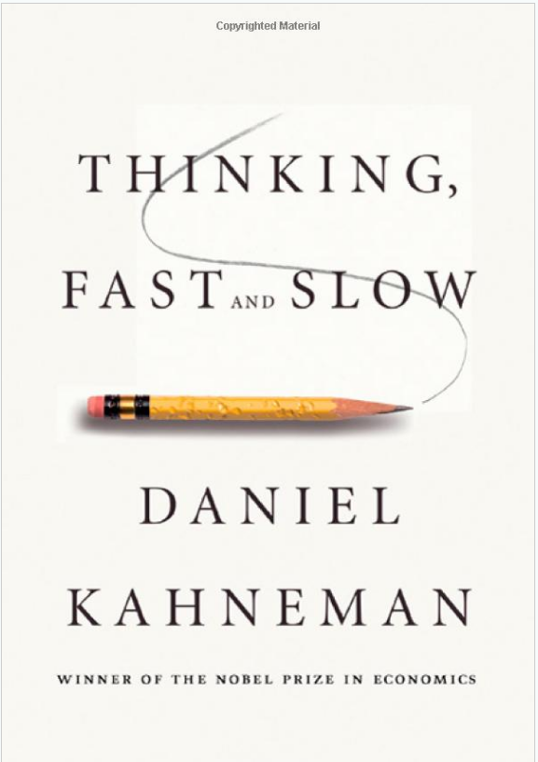
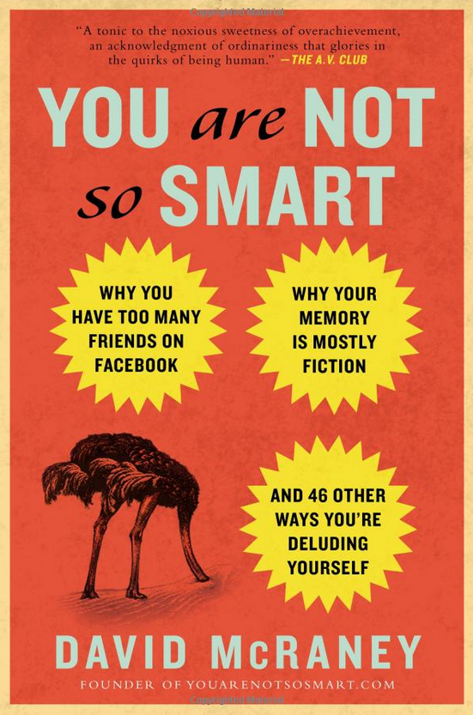
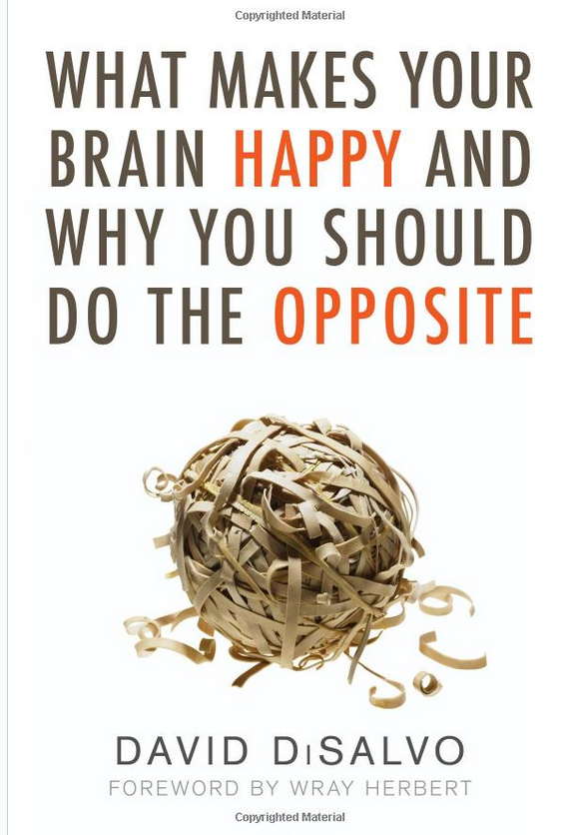
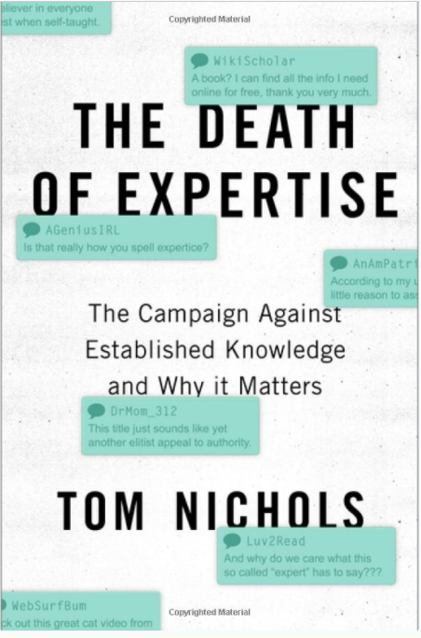
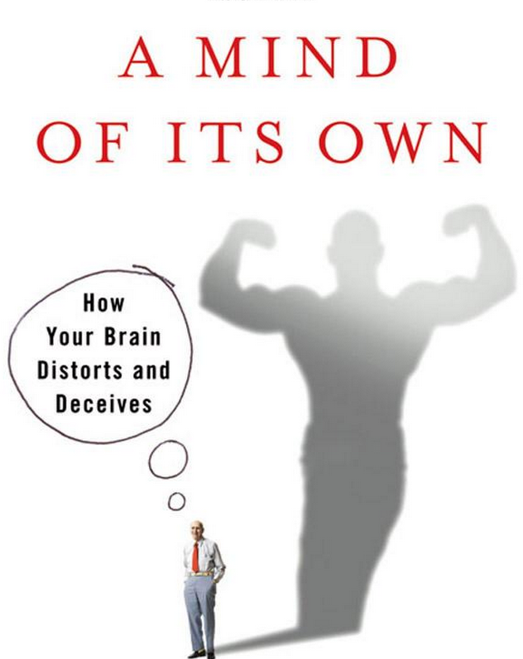
So what are we learning about social psychology and brain science that’s relevant to deliberative engagement?

Slide 22
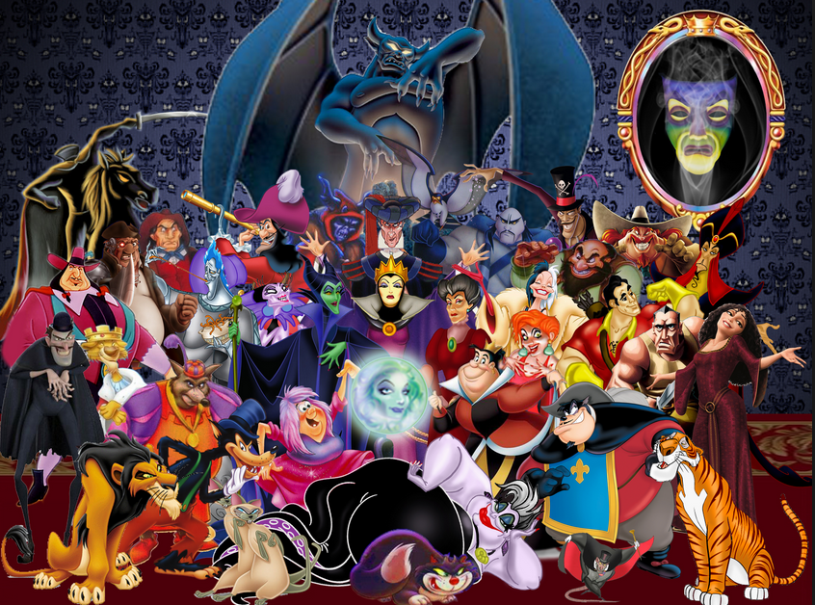
What Are We Learning from Brain Science and Social Psychology?
The Problematic
We crave certainty and consistency
We are suckers for the good v. evil narrative

Slide 23
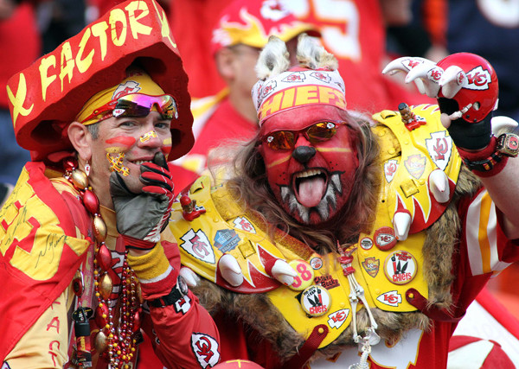
What We Are Learning from Brain Science and Social Psychology?
The Problematic
We crave certainty and consistency
We are suckers for the good v. evil narrative
We are “groupish” (prefer to gather with like-minded)

Slide 24
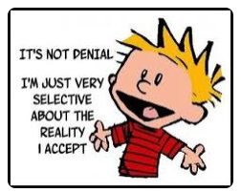
What We Are Learning from Brain Science and Social Psychology?
The Problematic
We crave certainty and consistency
We are suckers for the good v. evil narrative
We are “groupish” (prefer to gather with like-minded)
We filter & cherry pick evidence to support our views

Slide 25
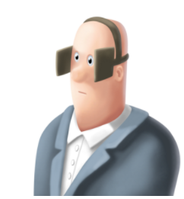
What We Are Learning from Brain Science and Social Psychology?
Stages of motivated reasoning
What and who we expose ourselves to | selective exposure / echo chambers/ filter or media bubbles

Slide 26
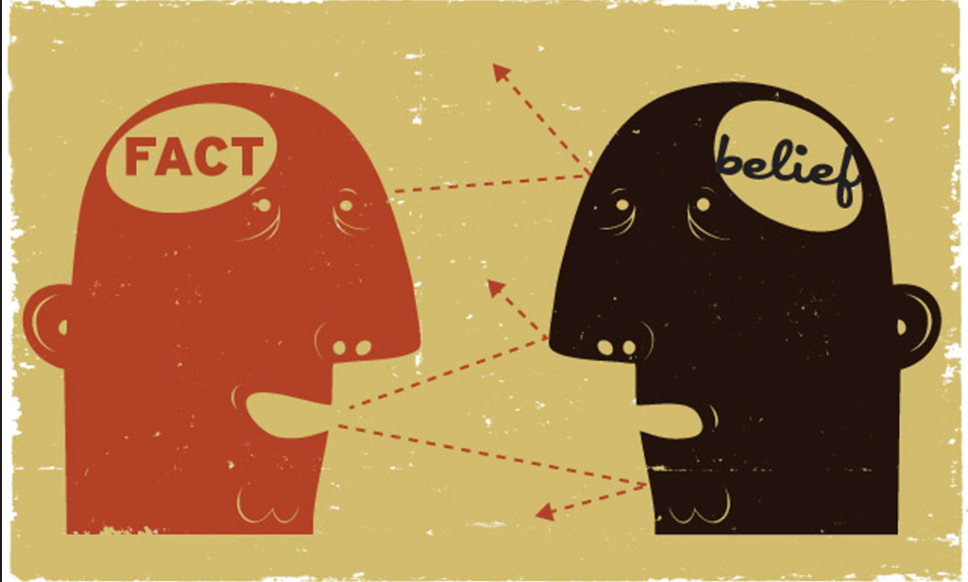
What We Are Learning from Brain Science and Social Psychology?
Stages of motivated reasoning
What and who we expose ourselves to | selective exposure / echo chambers/ filter or media bubbles
How we interpret new evidence | confirmation bias, backfire effect, cognitive dissonance

Slide 27
How we interpret new evidence
“when we want to believe something, we ask ourselves, ‘Can I believe it?’ Then…we search for supporting evidence, and if we find even a single piece of pseudo-evidence, we can stop thinking.… In contrast, when we don’t want to believe something, we ask ourselves, ‘Must I believe it?’ Then we search for contrary evidence, and if we find a single reason to doubt the claim, we can dismiss it“
Jonathan Haidt and Tom Gilovich

Slide 28
What We Are Learning from Brain Science and Social Psychology?
Stages of motivated reasoning
What and who we expose ourselves to | selective exposure / echo chambers/ filter or media bubbles
How we interpret new evidence | confirmation bias, backfire effect, cognitive dissonance

Slide 29
What We Are Learning from Brain Science and Social Psychology?
Stages of motivated reasoning
What and who we expose ourselves to | selective exposure / echo chambers/ filter or media bubbles
How we interpret new evidence | confirmation bias, backfire effect, cognitive dissonance
How we make attributions and tell stories | egoism, illusory correlation, negativity bias

Slide 30
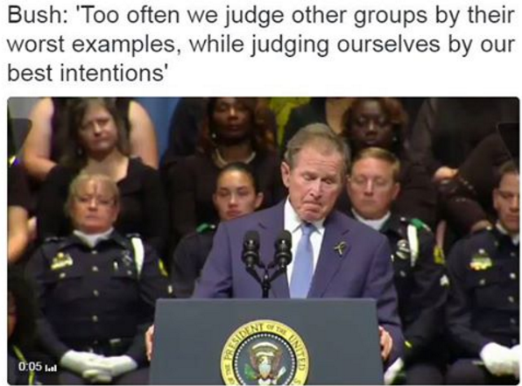

Slide 31
What We Are Learning from Brain Science and Social Psychology?
Stages of motivated reasoning
What and who we expose ourselves to | selective exposure / echo chambers/ filter or media bubbles
How we interpret new evidence | confirmation bias, backfire effect, cognitive dissonance
How we make attributions and tell stories | egoism, illusory correlation, negativity bias
How we make decisions | heuristics, self-serving bias, social proof

Slide 32
What We Are Learning from Brain Science and Social Psychology?
Stages of motivated reasoning
What and who we expose ourselves to | selective exposure / echo chambers/ filter or media bubbles
How we interpret new evidence | confirmation bias, backfire effect, cognitive dissonance
How we make attributions and tell stories | egoism, illusory correlation, negativity bias
How we make decisions | heuristics, self-serving bias, social proof
What we remember | availability bias

Slide 33
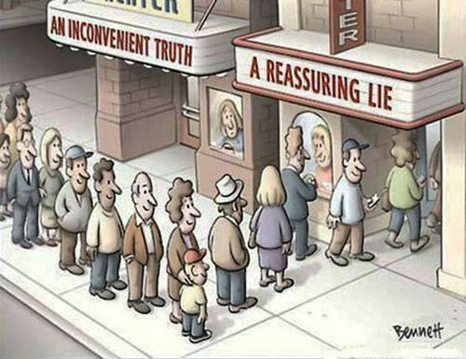
What We Are Learning from Brain Science
The Problematic
We crave certainty and consistency
We are suckers for the good v. evil narrative
We strongly prefer to gather with the like minded
We filter & cherry pick evidence to support our views
We avoid values dilemmas, tensions, and tough choices

Slide 34
The Vicious Cycle of Exaggerated Polarization
Individually developed subconscious biases

Slide 35
The Vicious Cycle of Exaggerated Polarization
Individually developed subconscious biases
Negative interaction effects

Slide 36
Negative Interaction Effects
Kathryn Shultz – Being Wrong
First step: Ignorance assumption
Second step: Idiot assumption
Third Step: Evil assumption

Slide 37
The Vicious Cycle of Exaggerated Polarization
Individually developed subconscious biases
Negative interaction effects
The
Russell
effect

Slide 39
Overview: Three Key Arguments
#1 – The Basic Reality
Most of the key problems we face are best understood through a wicked problems lens
#2 – The Bad News
Human nature and many of our primary institutions and processes are woefully ill-suited to address wicked problems
#3 – The Hopeful News
Once we realize #1 and #2, we can build capacity for the kinds of conversations, processes, and institutions that cultivate the wisdom so critical to addressing wicked problems, particularly at the local level

Slide 40
The Vicious Cycle of Exaggerated Polarization
Individually developed subconscious biases
Negative interaction effects
The
Russell
effect

Slide 41
The Vicious Cycle of Exaggerated Polarization
Individually developed subconscious biases
Negative interaction effects
The
Russell
effect
Impact of the internet

Slide 42
The Vicious Cycle of Exaggerated Polarization
Individually developed subconscious biases
Negative interaction effects
Overly
adversarial
political system
The
Russell
effect
Impact of the internet

Slide 43
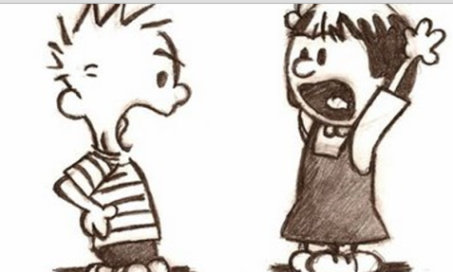
Drawbacks of an Overly-Adversarial Political System
Plays into flaws of human nature
Often focuses on “winning” vs. solving problems
Zero-sum game incentivizes “bad” communication, strategic research, and problematizes implementation
Often focuses on blaming (them) vs. taking accountability (us)
Relies on narrow value frames (thus avoids tensions)
Attracts/privileges organized, entrenched voices
Negative side effects like polarization, cynicism, and apathy (which then cause even worse communication)
Assumes a narrow role for citizens (citizens as voters, consumers, or spectators)

Slide 44
Overview: Three Key Arguments
#1 – The Basic Reality
Most of the key problems we face are best understood through a wicked problems lens
#2 – The Bad News
Human nature and many of our primary institutions and processes are woefully ill-suited to address wicked problems
#3 – The Hopeful News
Once we realize #1 and #2, we can build capacity for the kinds of conversations, processes, and institutions that cultivate the wisdom so critical to addressing wicked problems, particularly at the local level

Slide 45
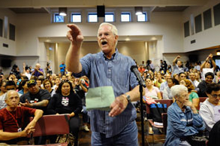
The Problem We Face
Most of our processes for public engagement and community problem solving primarily activate the negative aspects of human nature, and rarely tap into or nurture the positive.

Slide 46
Consider our Typical Public Processes
Our two-party system
Campaigns, referenda, and elections
“Town halls”
Interest groups and lobbyists
Political debates
Congressional deliberations and legislative debate
Social media political engagement
Citizen comment and public hearings
Expert panels
Letters to the editors
Emails and email campaigns to policymakers

Slide 47
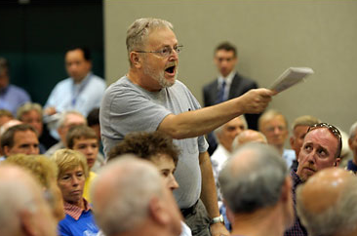
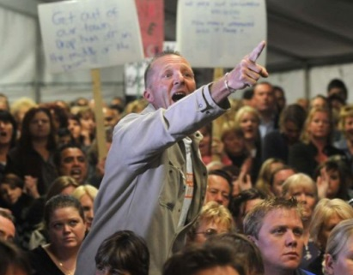
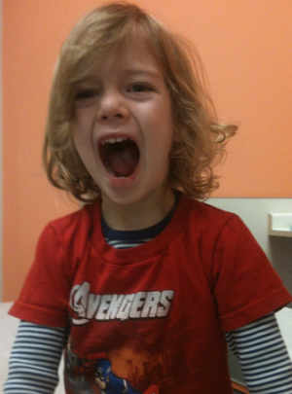
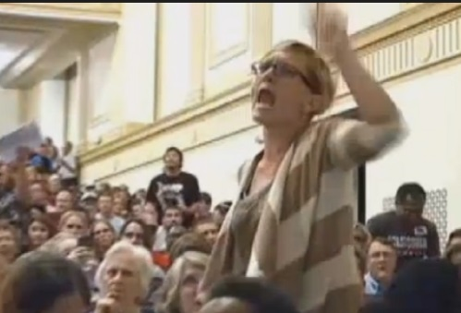
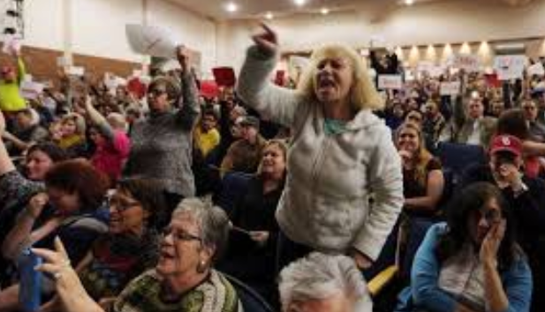
Traditional Forms of Public Participation
Government
Citizens
Citizens
Input
Citizens
Citizens
Citizens

Slide 48
Key Problems with our Typical Public Processes
Engage too late in the process when issues are simply framed as “yes” or “no”
Primarily provide opportunities for individual or group expression
Caters to entrenched and organized voices
Little to no effective interaction or learning/refinement of opinion

Slide 49
The Vicious Cycle of Exaggerated Polarization
Individually developed subconscious biases
Media focus on conflict
Negative interaction effects
Overly
adversarial
political system
The
Russell
effect
Impact of the internet

Slide 50
Why Experts Can’t Save Us (though they can certainly help when used well)
Good data is undermined in a polarized environment
Facts don’t change minds or behavior
Experts by definition are focused on a specific, narrow aspect of the problem (i.e. they struggle with wicked problems).
Experts often focus on being “value free” (they tell us what is or what could be, not what should be)
Expert perspectives can overemphasize what can be measured and underemphasize what cannot
Expert dominated processes shut out the public

Slide 51
Overview: Three Key Arguments
#1 – The Basic Reality
Most of the key problems we face are best understood through a wicked problems lens
#2 – The Bad News
Human nature and many of our primary institutions and processes are woefully ill-suited to address wicked problems
#3 – The Hopeful News
Once we realize #1 and #2, we can build capacity for the kinds of conversations, processes, and institutions that cultivate the wisdom so critical to addressing wicked problems, particularly at the local level

Slide 52
Key Steps for Local Communities
Adopting a wicked problems mindset
Short term
Long term

Slide 53
The Wicked Problems Mindset
Presume wicked problems, not wicked people
Become more comfortable with uncertainty
Focus on elevating the conversation not just winning the argument

Slide 54
Traditional v. Facilitative Leadership
Traditional
Strong opinion
Charisma
Public speaking skills
Mobilization of the like-minded
Facilitative
Strong on process
Trust and respect
Facilitation skills
Collaboration between broad perspectives

Slide 55
The Wicked Problems Mindset
Presume wicked problems, not wicked people
Become more comfortable with uncertainty
Focus on elevating the conversation not just winning the argument
Put your energy toward identifying, engaging, and negotiating inherent tensions
Work toward creating a learning community

Slide 56
Key Steps for Local Communities
Adopting a wicked problems mindset
Better processes - tap into different aspects of human nature
Short term
Long term

Slide 57
What We Are Learning from Brain Science
The Problematic
We crave certainty and consistency
We are suckers for the good v. evil narrative
We strongly prefer to gather with the like minded
We filter & cherry pick evidence to support our views
We avoid values dilemmas, tensions, and tough choices

Slide 58
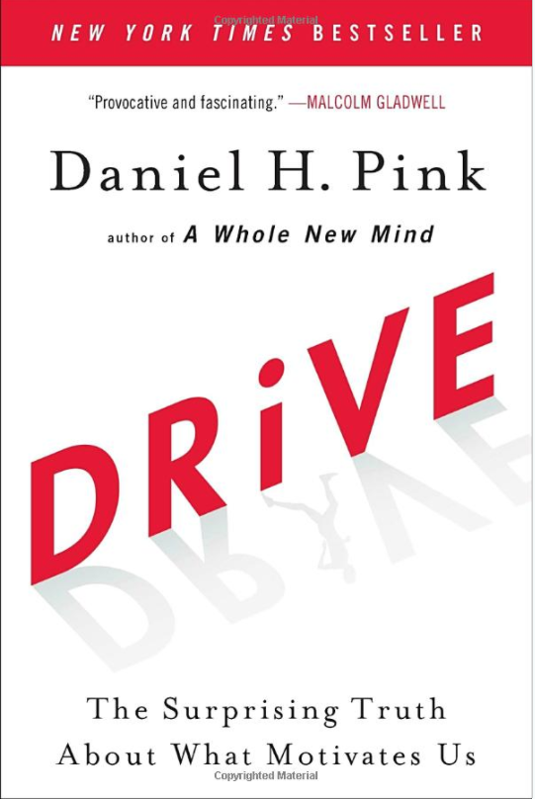
What We Are Learning from Social Psychology and Brain Science
The Good
We are inherently social and seek purpose and community

Slide 59
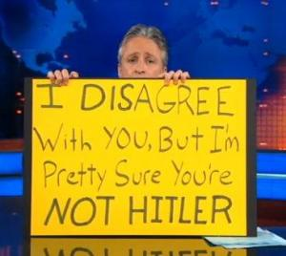
What We Are Learning from Social Psychology and Brain Science
The Good
We are inherently social and seek purpose and community
We are inherently empathetic
We are inherently pragmatic and creative
We can overcome our bad tendencies and build better habits

Slide 60
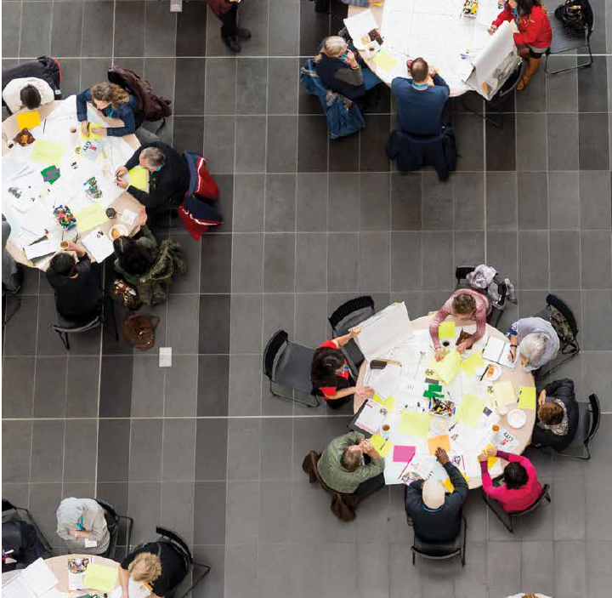
What We Are Learning from Social Psychology and Brain Science
Bottom line: The most powerful thing to help people overcome their biases and tackle wicked problems well is genuine conversation with people they respect.

Slide 61
Key Steps for Local Communities
Adopting a wicked problems mindset
Better processes - tap into different aspects of human nature
Build local capacity for deliberative engagement
Short term
Long term

Slide 62
What is Deliberative Engagement?
Deliberative democracy
Community problem-solving
Collaborative problem-solving
Participatory decision-making
Slow democracy
Strong democracy
Multi-stakeholder dispute resolution
Public participation
Democratic governance
Collaborative governance
Organic or community politics
Consensus building or seeking processes
Organic politics

Slide 63
Key Components of Deliberative Engagement
Overall deliberative framing
Wicked problem, multiple approaches, broad range of actors, starting discussion “upstream” (before polarization)
Discussion guides/backgrounder
Base of information, something to react to, framed for deliberation, not persuasion
Small, diverse, representative groups
Processes designed for interaction and learning

Slide 64
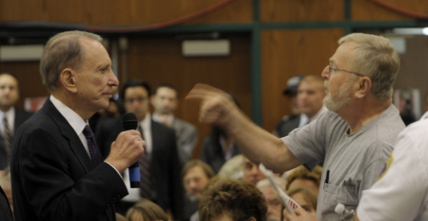
Traditional Forms of Public Participation
Government
Citizens
Citizens
Input
Citizens
Citizens
Citizens

Slide 65
Government
Non-profits
Private
Sector
Citizens
Experts
Deliberative
Engagement
Citizens
Citizens
Citizens

Slide 66
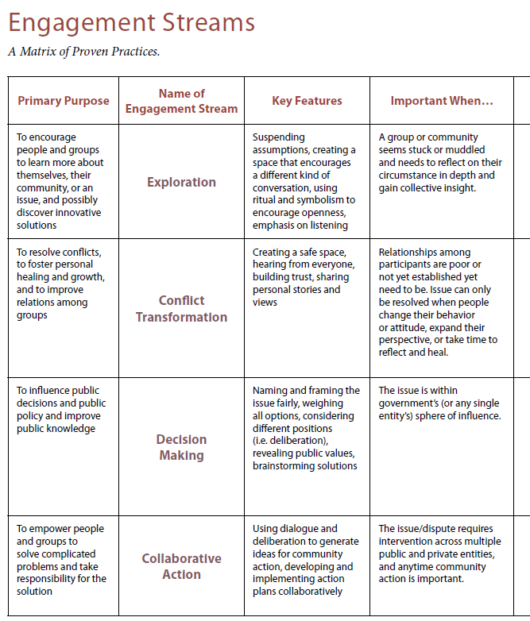
National Coalition for Dialogue and Deliberation
www.ncdd.org

Slide 67
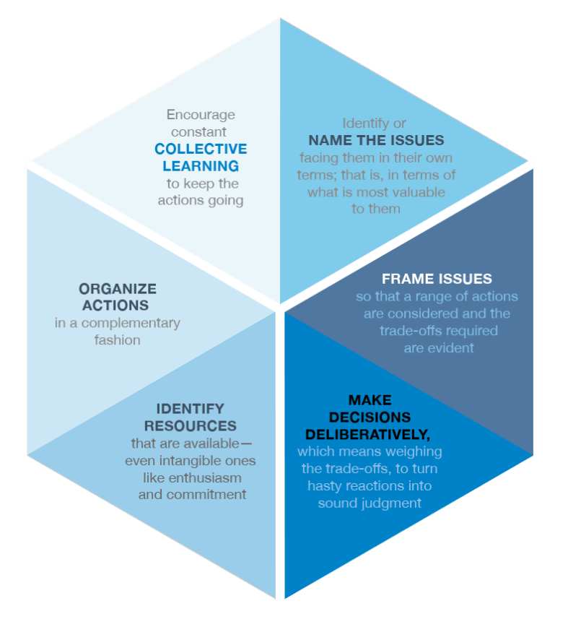
Kettering Foundation’s
Six Democratic Practices
https://www.kettering.org/core-insights/democratic-practices

Slide 68
Key Components of Deliberative Engagement
Overall deliberative framing
Wicked problem, multiple approaches, broad range of actors, starting discussion “upstream” (before polarization)
Discussion guides/backgrounder
Base of information, something to react to, framed for deliberation, not persuasion
Small, diverse, representative groups
Processes designed for interaction and learning
Deliberative facilitators

Slide 69
The Four Key Shifts of Deliberative Engagement
From wicked people
→ to wicked problems
From adversaries
to collaborators
From inciting the worst of human nature
to bringing out the
best of human nature
From facts as cherry picked ammunition or “fake news”
to facts as tools for
addressing problems
together

Slide 70
Key Steps for Local Communities
Adopting a wicked problems mindset
Better processes - tap into different aspects of human nature
Build local capacity for deliberative engagement
Reinvigorate or create new key bridging institutions
Short term
Long term

Slide 71
Institutional Troubles Bridging v. Polarizing Institutions
More polarizing
Political parties/elections
Advocacy groups
Internet / Social media
Media/Press
Experts
School districts
Universities
Community organizations like Leadership Foundations, League of Women Voters, United Way, Community Foundations, , Leadership programs, Boards and Commissions
More bridging

Slide 72
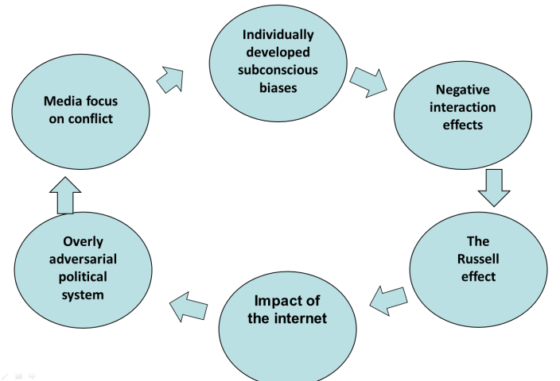
Institutional Troubles Bridging v. Polarizing Institutions
Political parties/elections
Advocacy groups
Internet / Social media
Media/Press
Experts
School districts
Universities
Community organizations like Leadership Foundations, League of Women Voters, United Way, Community Foundations, Leadership programs, Boards and Commissions
More polarizing
More bridging

Slide 73
Key Steps for Local Communities
Adopting a wicked problems mindset
Better processes - tap into different aspects of human nature
Build local capacity for deliberative engagement
Reinvigorate or create new key bridging institutions
Cultivate citizens as wise collaborators
Short term
Long term

Slide 74
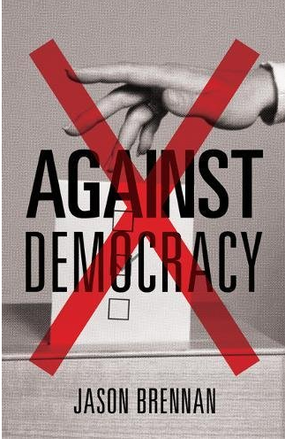
Brennan’s Against Democracy
Three types of citizens:
Hobbits
Hooligans
Vulcans
Wise collaborators

Slide 75
The Vicious Cycle of Exaggerated Polarization
Individually developed subconscious biases
Media focus on conflict
Negative interaction effects
Overly
adversarial
political system
The
Russell
effect
Impact of the internet

Slide 76
The Virtuous Cycle of Authentic Engagement
Opportunity for authentic
engagement
(primary at local level)
Potential for collaboration and co-creation
Development
of mutual
understanding
Greater refinement
of opinions
(i.e. learning)
Building of trust and respect

Slide 77
The remaining slides were not part of the initial presentation, but may be utilized during the Q&A session.

Slide 78
Sam Kaner, Facilitator’s Guide to Participatory Decision-Making

Slide 79
Not allowing enough divergent opinion
leads to
False consensus
(dissent not heard, wishful thinking supported,
decisions likely either faulty or
Unsustainable, often attracting
strong opposition)
To avoid false consensus:
Communities need better processes to insure adequate divergent thinking and that voices are heard.

Slide 80
Exiting groan zone too early
leads to
False polarization
(sparks misunderstanding, distrust,
unsustainable one-sided solutions,
fact wars develop, spirals of conflict)
To avoid false polarization:
Communities need better processes to help them work through tough choices.

Slide 81
Getting stuck
in groan zone
leads to
Paralysis by
Analysis
(no decisions,
frustrations with process,
chilling effect for
future engagement)
To avoid paralysis by analysis:
Communities need better processes for collaboration and moving from talk to action

